Slide 1
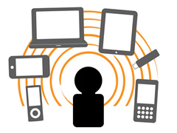
E- izobraževanje
Uvod
Saša Divjak
Sasa.divjak@fri.uni-lj.si

Slide 2
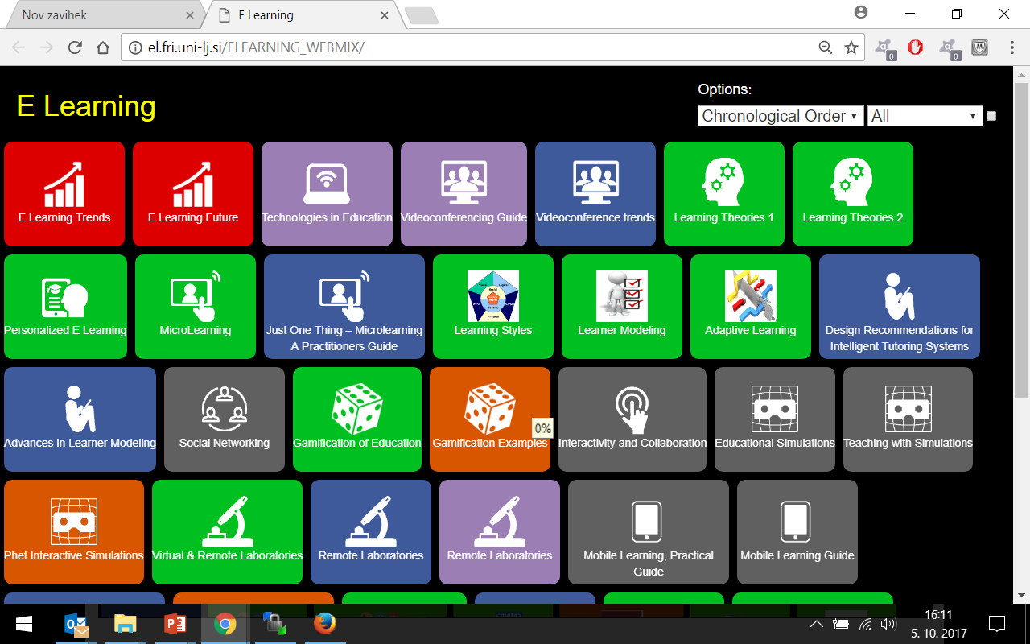
Gradiva na: http://el.fri.uni-lj.si/ELEARNING_WEBMIX/

Slide 3

Zakaj bi sploh poslušal ta predmet?
Vseživljensko učenje (ob delu, v resničnem življenju)
Projekti s področja E-izobraževanja
Nekateri boste sodelovali pri e-poučevanju in e-učenju

Slide 4
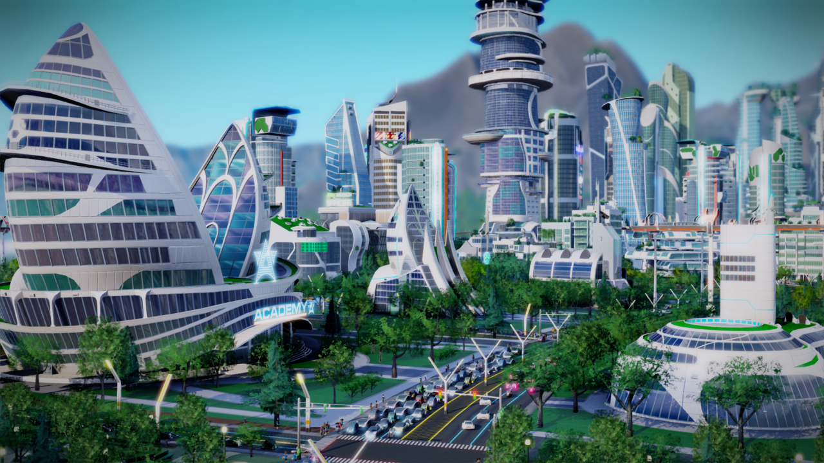
Izobraževanje v 21 stoletju
Tehnologija revolucionarno spreminja poslovanje in učenje
Kjerkoli – kadarkoli - kdorkoli
„Just-in-time“ dostop do informacij in znanja
Vsebine poosebljenega učenja
Izboljšano sodelovanje in interaktivnost med študenti

Slide 5
Tehnologije in modeli učenja
Real Work &
Learning
Indistinguishable
Open up time and place
for learning
Open up time and place
for extended operations and
improved decision making
Knowledge
Creation/
Exchange
Personal Devices
Pervasive Computing
Empowered
Future
Skills
Transfer
Collaborative Technology
Now
Data and analysis where
and when you need it
Pre-Web
Interactive Technology
Information
Transfer
Distribution Technology
Controlled
Centralized
Decentralized
Authority-
Centered
Recipient-
Centered
Team-
Centered

Slide 6
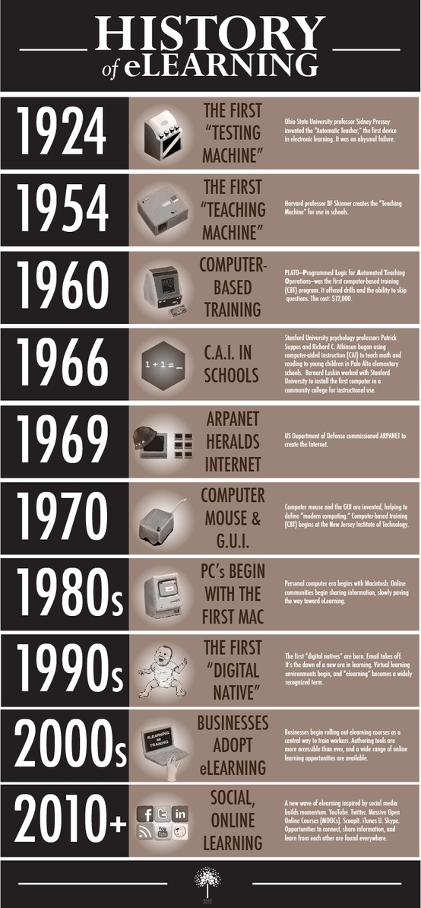
Časovni trak e-izobraževanja
WEB
A brief history of elearning

Slide 7
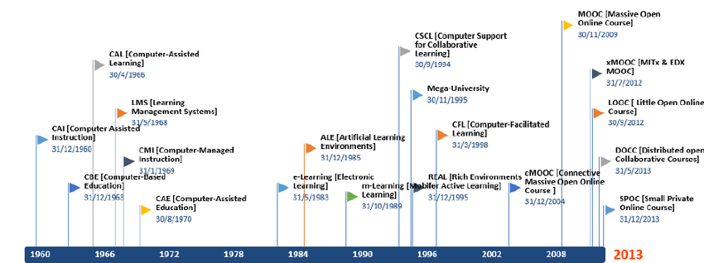
Časovni trak e izobraževanja

Slide 8
Trendi v e izobraževanju
LMS
Video
Chunking
Big Data
2014
2020
Media
Tools
Gaming
Content Networks

Slide 9

Trendi v izobraževanju
Vsak uporabnik ima po več naprav
Flash umira, HTML5 v porastu
Vzpon video vsebin (Primer tečaja JavaScript)
Obogatena resničnost
Porast in razvoj LMS

Slide 10
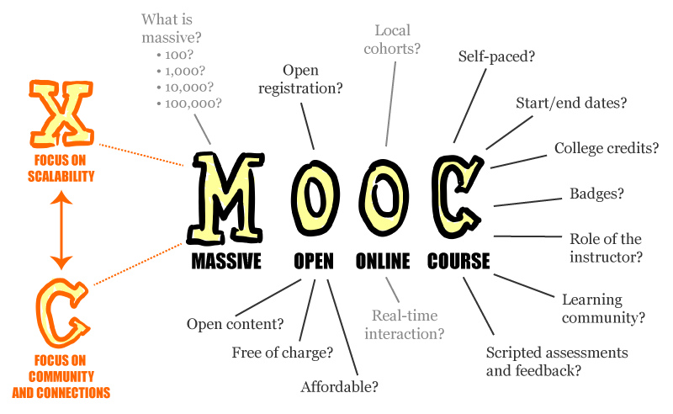
MOOC
WEB
Do leta 2020 naj bi vsaj kakšen ducat univerz ponujalo MOOC

Slide 11
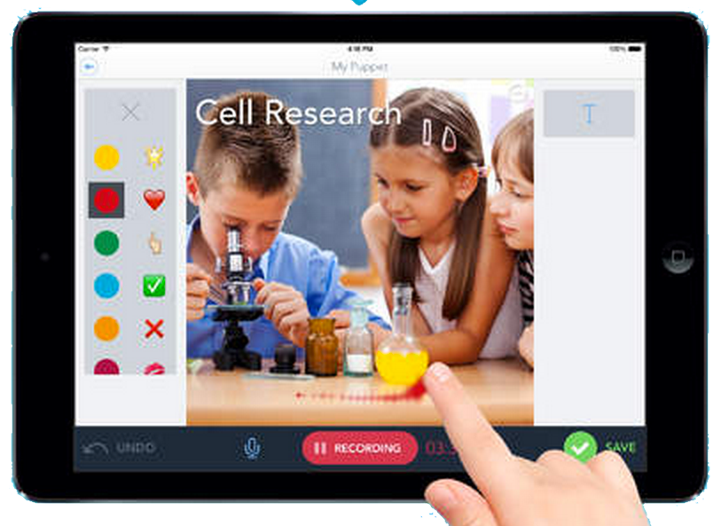
Video vsebine na mobilnih napravah
67% uporabnikov pametnih telefonov gleda video.
14% uporablja video vsaj enkrat na dan.
Zato je uporaba videa v e-izobraževanju v vzponu. Skupaj z digitalnim pripovedovanjem zgodb.
WEB

Slide 12
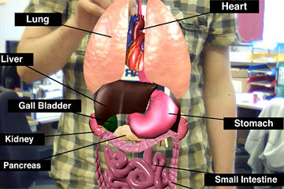

Obogatena resničnost v izobraževanju
Obogatena resničnost omogoča prekrivanje realnega okolja z virtualnimi objekti, s katerimi lahko interaktiramo in tako dobimo večjo angažiranost tudi pri e-izobraževanju. Pojav Google Glass , Oculus Rift , HTC Vive ipd. lahko pomeni mejnik pri tako podprtem učenju.
WEB
WEB

Slide 13
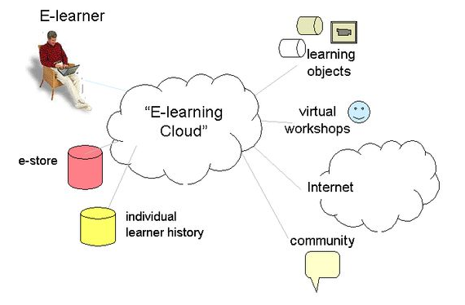
Storitve v oblaku
“Cloud computing“ je eden glavnih tehnoloških trendov. Najbolj pride do izraza pri sistemih za upravljanje z učenjem (Learning Management Systems). LMS v oblaku nudijo avtomatizirano posodabljanje in izboljševanje.
WEB
WEB

Slide 14
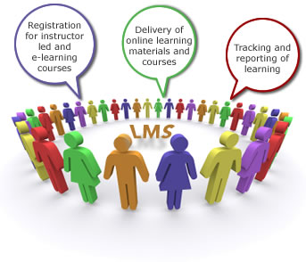

Porast in razvoj LMS (spletnih učilnic)
Te bodo centralni element pri strategijah učenja na delovnem mestu
LMS bodo podpirali (ne upravljali) formalno + neformalno + socialno učenje

Slide 15
Kmalu na tvoji spletni učilnici (LMS)
MOOC zmožnosti – Korporativne, mešane
Video urejanje,
mobilno zajemanje videa?
MOOC
Video
2014-18
Asinhrono izobr.
LRS
Ali ni že kar pozno?
Pomisleki, predvsem o varnosti in privatnosti,
a tega se ne da zaustaviti

Slide 16

LMS bodo podpirali (ne upravljali) formalno + neformalno + socialno učenje
Zmožnost merjenja neformalnega učenja naj bi omogočal sam sistem
To bo predstavljalo premik v pogled na ocenjevanje
Stalno sledenje naj bi načrtovalcem pomagalo pri nadzoru performans sistema in uporabnikov

Slide 17
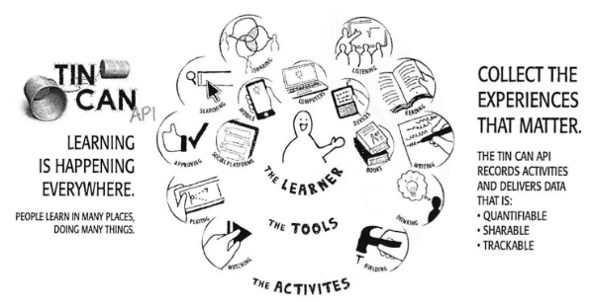
Tin Can nadomešča SCORM
Tin Can je „Learning Record Store“ (LRS), zmožen sledenja napredku učenca pri njegovem angažiranju v formalnem in neformalnem, socialnem učenju. Tin Can naj bi kot industrijski standard nadomestil SCORM.

Slide 18

„Masovni podatki (big data)
Večina izobraževalnih ustanov mora kvantitativno dokazovati vrednost svojih izobraževalnih strategij s statističnimi in poglobljenimi informacijami. Pokazati moramo tudi učinkovitost digitalnega učenja.
Povečano privzemanje „masovnih podatkov“ bo administratorjem e-izobraževanja omogočilo poosebljenje učnih vsebin, povečanje pravočasne motivacije in preverjanje učinkovitosti različnih učnih teorij in strategij.
WEB

Slide 19

Masovni podatki in napredna, vseprisotna, nevidna analitika
Pravi podatki v pravem trenutku vzpodbudijo našo produktivnost.”
Množice podatkov pridobivamo iz aplikacij, tudi iz socialnih medijev, oblačljivih naprav.
Podatke moramo urediti in filtrirati glede na naše potrebe
Prave informacije moramo v pravem času posredovati pravim osebam.
Analitika bo postala poglobljena, vendar nevidno vgrajena povsod.
Napredna, vsepovsodna in nevidna analitika bo eden od 10 strateških tehnoloških trendov.

Slide 20

Poosebljenje učenja
Poosebljeno učenje nudi učencem kontrolo lastnega učenja.
Fokusirano je na interese učenca in njihovo zmožnost ter tempo učenja
Razumevanje, kaj se učijo
Svoboda pri načrtovanju lastnega predmetnika
Učenci so lahko tudi v vlogi eksperta za določeno strokovno področje ali tehnologijo.
Lahko tudi tvorijo vsebine

Slide 21
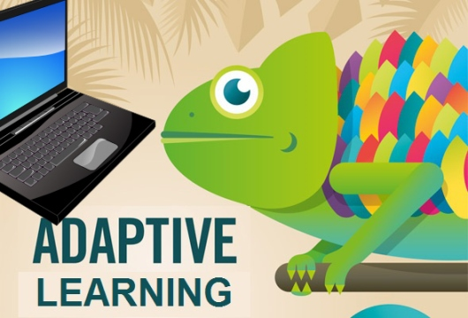
Adaptivni in na kompetencah temelječi programi
Adaptivni modeli, osnovani na kompetencah, omogočajo učencu izločanje že znanega ali nepotrebnega gradiva.
Tako ostajajo izvežbani uporabniki angažirani in prihranijo čas s pregledovanjem gradiv, ki jih že poznajo in se osredotočijo na hitrejše učenje novega.

Slide 22
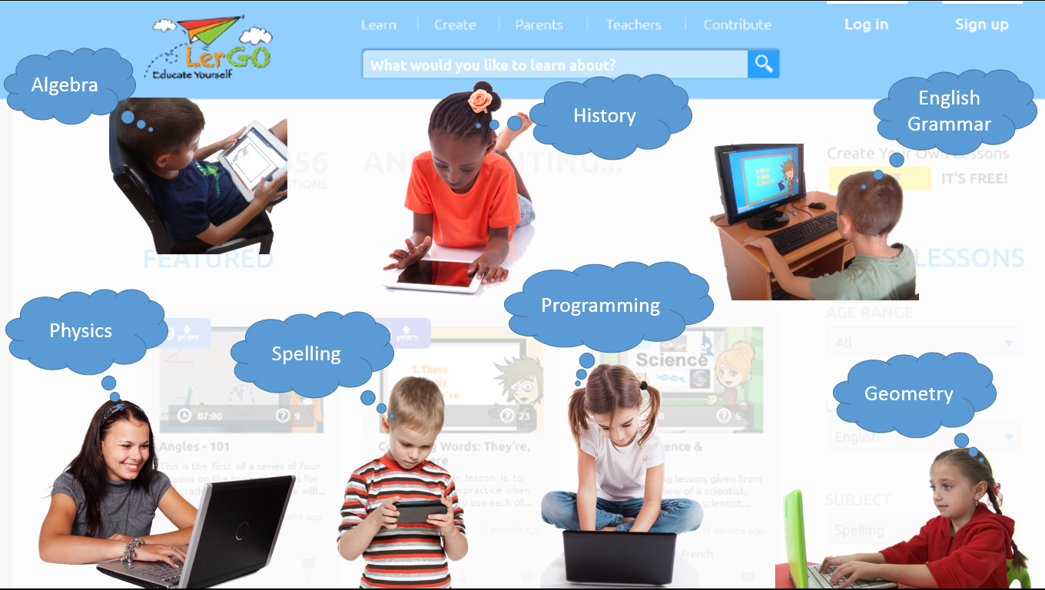
Učenje z lastnim tempom

Slide 23

Bring your own device (BYOD)
Vsak prinaša svojo napravo s seboj

Slide 24

Izobraževanje na delovnem mestu
Mobilne naprave omogočajo izobraževanje na delovnem mestu
Informacije „Just-in-time“ (video, dokumenti, mini tečaji, priročniki), dostopne učencem preko informacijskega sistema podjetja
Sodelovanje s sodelavci
Učenci lahko tudi sami tvorijo vsebino preko mobilnih naprav

Slide 25

Učenje spotoma (learning on the go)
Smo v svetu, ko so vsi zasedeni in nihče nima časa za nič.
Rešitev najdemo v mobilnem učenju.

Slide 26

Mobilno učenje (m-learning)
V razliko od tradicionalnega e izobraževanja nudi mobilno izobraževanje (m-learning) dostop do zapiskov, nalog, slik, klepetalnic, multimedijskih zapisov tudi v prostem času zaposlenega oziroma učenca.
To pa pomeni časovni prihranek tako za posameznika kot za ustanovo ali podjetje. Zato je mobilno izobraževanje eden od trendov!

Slide 27
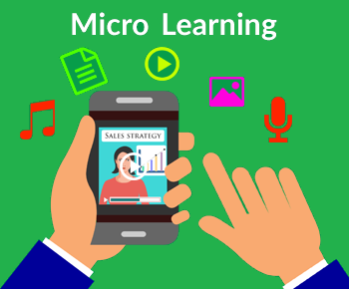
Mikro učenje (microLearning)
Mikro učenje govori o zelo kratkih učnih gradivih.
Vendar tako učenje ni le kompaktno, je tudi fokusirano.
Nudi ravno pravšnjo informacijo za doseganje določenega cilja.
Kratek video, hitra igra, pripomoček pri delu.
Mikro učenje je kratka lekcija na določen predmet. Traja od 30 sekund do največ nekaj minut. In nas pri delu ne bremeni.

Slide 28

Poigritev izobraževanja
Igre (in simulacije) bodo postale integralni del učenja na delovnem mestu
Kultura iger bo vsepovsodna. Cena razvoja iger se manjša in s tem je večja sprejemljivost iger.
Izobraževalnim oddelkom se vloga spreminja:
od ponudnikov tečajev k povezovalcem,
Rešitve, ki angažirajo (kot igre) postajajo pomembne

Slide 29
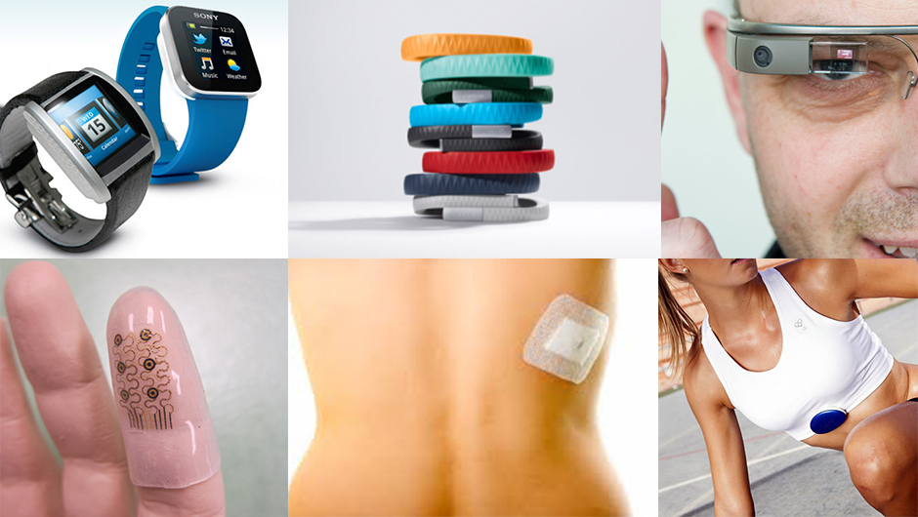
Nosljivo učenje (wearable learning)

Slide 30
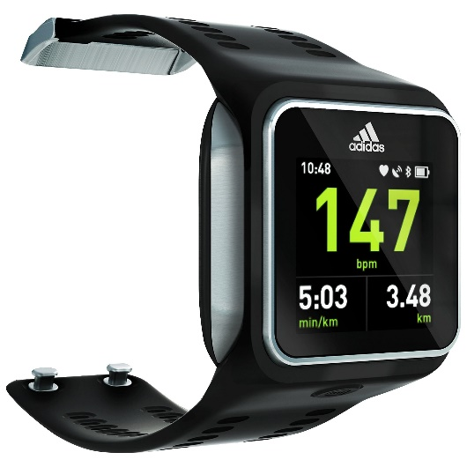
Nosljivo e-učenje
Nosljivo e-učenje je izraz, ki pomeni „medtem, ko delate“. Primer je „pametna ura“. Njen zaslonček sicer ni primeren za vse vrste mobilnega učenja, lahko pa nas opozarja, če kaj delamo narobe (ali nevarno) s senzorji gibanja (pospeškometri, žiroskopi, merilci pritiska). Stvar je lahko podobna virtualnemu vodenju v realnem času
Primer Adidasov miCoach Smart

Slide 31
Nosljiva tehnologija
Google Glass, Oculus Rift, Apple Watch in Android Wear postajajo popularni.
Zato, ker postaja tehnologija prijazna in cenovno dostopna.
Nosljive naprave spreminjajo način dostopa do informacij.
Simulacije in spletni scenariji se spreminjajo v dinamične in interaktivne izkušnje v spletnih vadbenih okoljih.

Slide 32

Več sodelovanja
Orodja za sodelovanje večajo produktivnost sodelavcev.
Tradicionalno izobraževanje v razredih ali posamično nadomešča socialno učenje (v učnih skupnostih).
Učenci sodelujejo in si delijo izkušnje.

Slide 33

družbeno in neformalno učenje
Pojav socialnih medijev in oživljena pozornost na družbeno in neformalno učenje

Slide 34

Pojav osebnih učnih agentov
Pojavile se bodo inteligentne osebne učne aplikacije kot mediatorji s semantičnim spletom
Ti agenti, ki tečejo na osebnih računalnikih, stalno nadzorujejo vsebino na spletu in zagotavljajo posodobljene informacije v podporo učnemu sistemu

Slide 35
Načrtovalec tečajev
Nove vloge učitelja
Učitelj
Sodelavec
Učitelj 21. stoletja
Učenec
Tihi partner
Koordinator ekipe
Svetovalec in moderator
Nadzorovanje in ocenjevanje napredka

Slide 36
Pomanjkanje časa in virov
Kultura šole
Sposobnosti učitelja
Kaj učitelj verjame
Omejitve

Slide 37
Učiteljeva vprašanja
Katere učne aktivnosti naj razvijam?
Kaj se morajo moji učenci naučiti?
Katera orodja naj uporabim?

Slide 38
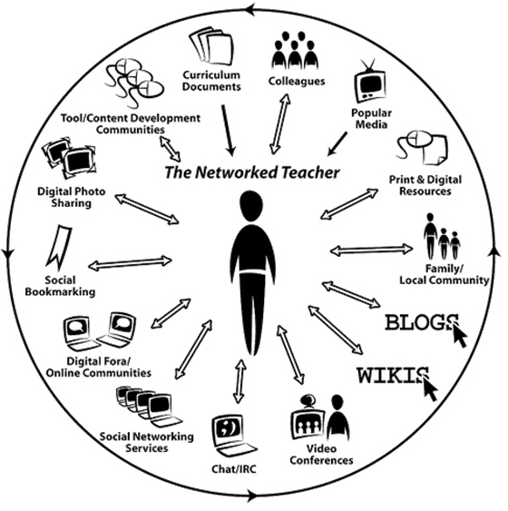
Omreženi učitelj

Slide 39
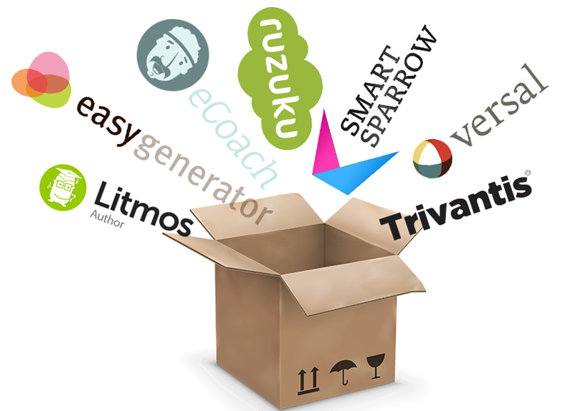
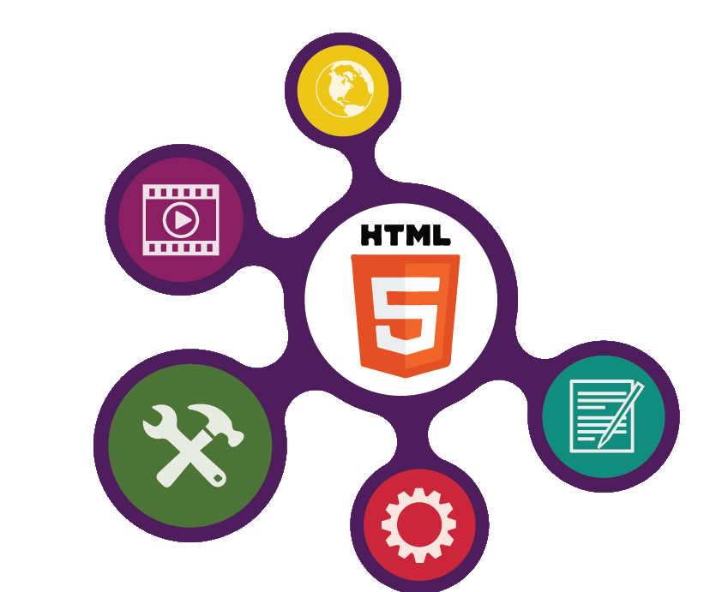
Avtorska orodja
WEB

Slide 40

3
Razvoj avtorskih orodij
Razvoj avtorskih orodij za boljše in lažje delo ob zmanjšani ceni razvoja e-gradiv
Orodja (kot so „thinking worlds“) omogočajo hitro tvorbo 3D podprtih odločitvenih simulacij (ali preprostih 3D iger)
Razvoj gradiv doma (In house authoring)

Slide 41
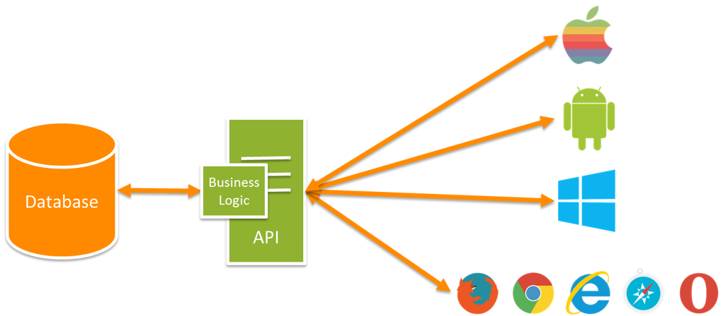

Aplikacijski programski vmesniki (API)
API (Application Programming Interface) določa, kako aplikacije interaktirajo med seboj. Uporabljamo ga pri izmenjavi podatkov in integraciji funcionalnosti med aplikacijami.
Pri e izobraževanju omogoča integracijo in povezovanje med spletnimi storitvami, analizo, posodobitve, prilagajanje in poigritve. Primera takih API najdemo n.pr. v SCORM in TinCan API
Tako lahko vsebina poteka med različnimi LMST. Tako lahko sledimo napredku učencev ipd.

Slide 42

Orodja za podporo učinkovitosti
(Performance Support Tools)
Omogočajo boljše izvajanje nalog. Mobilno učenje tako nudi vsebino, kadar in kolikor je potrebno (mobile learning, micro learning, responsive design).
Premostitev med virtualnim in realnim svetom podpirajo nosljive računalniške naprave in obogatena resničnost.

Slide 43
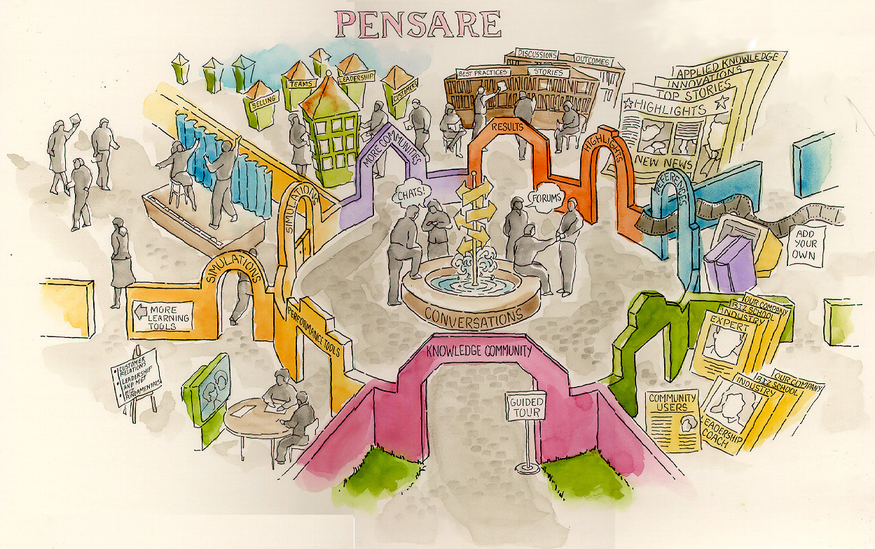

Slide 44
Contents
Management
Experience
Database
Server
PDF
Paper
Traditional Learning Events
Document Management
Installed on Desktop
DirectX
Community
.
Lecture
(Live/Recorded)
SCORM
AICC
.avi
.mov
(Learning) Content Management
Instant Messenger
Microsoft Messenger
CD-ROM
AICC
E-Workbook Content
Portal
Browser
Learning Management System
SCORM
Macromedia Flash
Web/
Application Server
Wireless
SMTP
val
Mail/List Serves and Calendar
Curriculum
Administrative Suite
Reporting Tool
Records
Notes:
E-Learning Bottom-Up
Implementing enterprises will have to assemble their own
The easiest way to segment e-learning is into
content and assessment,
management, and
end-learner.
Content and assessment refers to the standards,

Slide 45
Results
E-learning Content
Organizational Alignment
Simulations
Strategic “Must-Take” Course
New Intuitive Behavior
Employee Satisfaction
Embedded Help
Lower Turnover
Customer Satisfaction
New Process Behavior
Stand-alone E-learning Modules
Increased Access
Template and Documentation Libraries
Virtual Classroom
Project Management
One Contact Point
Learning Management Systems
Knowledge
Management
Completion Rate
Course Libraries
Online Communities
CRM
Integration
Cost Reduction
Search Tools
Rollout Assessment
Authoring Tools
Rollout Delivery
End-Learners
Portal
LCMS
Pilot Assessment
Process
Infrastructure
Pilot Delivery
Document
Management
Systems
Integration
Content Creation or Procurement
Audience Assessment
Manuals
Needs Assessment
Cut Budget/Consolidation
Standards
ERP
Integration
Alignment with Enterprise Strategy
Employee Survey
Magazines
Enabled by IT Infrastructure
Job-aides
Conferences
Customer Survey
Tactical
Videos
Workshops
Weak Enterprise
Results
Merger
Rolling out new internal offering
Help Desk
Lectures
Skunk Works
Changing External Conditions
Rolling out new external offering
Tier 2
Personal Action Plans
Apprenticeships
Long Term Skill Gap
Other Content
Source
Tier 3
New Compensation
New Enterprise Direction
Coaches
Strategic
Notes:
Bringing a knife to a gunfight
When we take our children in for a check-up, the doctor gets heights and weights, and then plots them to find out if the two are in accord. Is a child too thin for the height, or too heavy, or about right? When I look at an elearning implementation, the most important thing I look for is accord. Given the results desired, are the right processes, content, and infrastructure being involved?
For example, say an enterprise is rolling out a new internal offering, say a new benefits enrollment application. Let’s call this, relatively speaking, a tier-two level of training. The goal is to teach a new process-driven behavior, a tier-two result. Just putting out new templates and perhaps a chat room (tier-one e-learning content) would probably not be robust enough do the job. We would not expect to see the new process-driven behavior to catch-on.
On the other hand, doing a detailed need assessment, and using simulations and coaches (tier three), would be overkill. It would both cost too much for what we wanted to accomplish, and take too long. A better response would be to use tier-two and below across the board: a pilot to practice, virtual classrooms and lectures for content, supported by tier-ones such as new templates and chat rooms.
Here’s how you can use this chart to quickly test your own e-learning implementation. Look at the results you want. Also look at the cause of the program – what happened to make you think about the results. If these two are from different tiers, worry a little bit. If the cause is from a higher tier then the desired result, your sponsors and constituents may not be satisfied. If your results are from a higher tier then the cause, you may find the support for your program erodes as invoices roll in.
After you have identified the right tier, look at the processes, e-learning content, and infrastructure in that tier and the lower tiers. A tier three problem will involve all processes from tiers one, two, and three. You may not want to waste your time on processes from higher tiers. The primary content (both e-learning and other) should be from the same tier as the results, but use lower tiers for support.
This level of precision is necessary if we want to avoid the knowledge management misalignment of the mid-90’s. Back then, vendors would promise a top-tier result (having complete control of an enterprise’s intellectual assets) with a bottom-tier offering (a new server). The backlash against the misalignment put the KM discipline in the corporate penalty box for five years, out of which it is just emerging.
E-learning can be strong medicine, but we have to get the dosages right. Said another way, we have to follow the macabre piece of advice: “don’t bring a knife to a gunfight.”

Slide 46
Results
Mastery Level
E-learning Content
Full Dynamic Simulations
Increased Professional Value
Certification
Virtual Labs
New Intuitive Behavior
Standardized Test Results
Branching Stories
Interactive Spreadsheets
Credit
Project Management
Completion Rate
Increased Access
Workbook Libraries
Learning Management Systems
Online Communities
One Contact Point
Virtual Classrooms
Cost Reduction
Community Tools
Rollout Assessment
Authoring Tools
Portal
Content Management
Pilot Assessment
Rollout Delivery
End-Learners
Search Tools
Process
Infrastructure
Pilot Delivery
Content Creation or Procurement
Computers for Web Access
Audience Assessment
Computers supporting Real-Time 3D Interactions
Manuals
Needs Assessment
Cut Budget/Consolidation
Alignment with Strategy
Magazines
Enabled by IT Infrastructure
Hand-outs
Tactical
Videos
Labs
Virtual Coaches
Changing External Conditions
Skunk Works
Tier 2
Lectures
After Action Reviews
Long Term Skill Gap
Personal Action Plans
Apprenticeships
Tier 3
New Motivation
Other Content
Source
New Direction
Long Term Coaches
Strategic
Notes:
Bringing a knife to a gunfight
When we take our children in for a check-up, the doctor gets heights and weights, and then plots them to find out if the two are in accord. Is a child too thin for the height, or too heavy, or about right? When I look at an elearning implementation, the most important thing I look for is accord. Given the results desired, are the right processes, content, and infrastructure being involved?
For example, say an enterprise is rolling out a new internal offering, say a new benefits enrollment application. Let’s call this, relatively speaking, a tier-two level of training. The goal is to teach a new process-driven behavior, a tier-two result. Just putting out new templates and perhaps a chat room (tier-one e-learning content) would probably not be robust enough do the job. We would not expect to see the new process-driven behavior to catch-on.
On the other hand, doing a detailed need assessment, and using simulations and coaches (tier three), would be overkill. It would both cost too much for what we wanted to accomplish, and take too long. A better response would be to use tier-two and below across the board: a pilot to practice, virtual classrooms and lectures for content, supported by tier-ones such as new templates and chat rooms.
Here’s how you can use this chart to quickly test your own e-learning implementation. Look at the results you want. Also look at the cause of the program – what happened to make you think about the results. If these two are from different tiers, worry a little bit. If the cause is from a higher tier then the desired result, your sponsors and constituents may not be satisfied. If your results are from a higher tier then the cause, you may find the support for your program erodes as invoices roll in.
After you have identified the right tier, look at the processes, e-learning content, and infrastructure in that tier and the lower tiers. A tier three problem will involve all processes from tiers one, two, and three. You may not want to waste your time on processes from higher tiers. The primary content (both e-learning and other) should be from the same tier as the results, but use lower tiers for support.
This level of precision is necessary if we want to avoid the knowledge management misalignment of the mid-90’s. Back then, vendors would promise a top-tier result (having complete control of an enterprise’s intellectual assets) with a bottom-tier offering (a new server). The backlash against the misalignment put the KM discipline in the corporate penalty box for five years, out of which it is just emerging.
E-learning can be strong medicine, but we have to get the dosages right. Said another way, we have to follow the macabre piece of advice: “don’t bring a knife to a gunfight.”

Slide 47

Vsebina
Uradna vsebina
E-izobraževanje, modeli
Spletne tehnologije v izobraževanju
Računalniško podprte simulacije, animacije, eksperimenti
Mikro učenje
Računalniško podprte tehnologije sodelovanja
Ponovno uporabljivi učni objekti
Sistemi za upravljanje učenja (spletne učilnice)
Digitalne knjižnice
Socialna omrežja v e-izobraževanju
Kvaliteta e-izobraževanja

Slide 48


Zanimive spletne strani

Slide 49

Zanimiva spletna stran
WEB

Slide 50
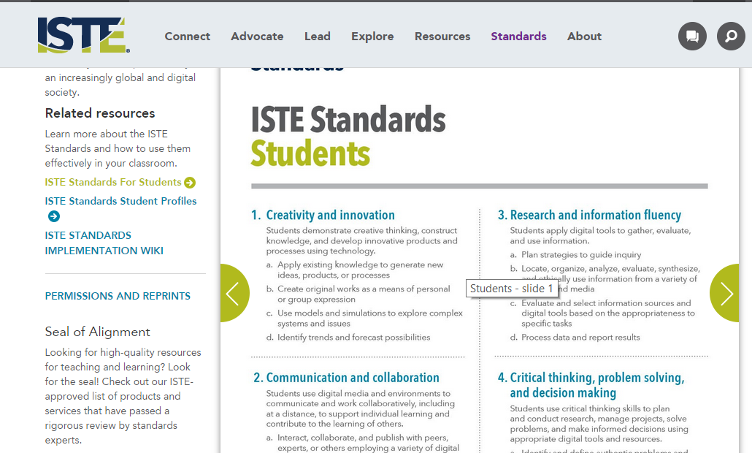
ISTE Standardi za študente

Slide 51
Literatura za ta predmet?
Epignosis LLC : E-learning, concepts, trends, applications (local pdf) (****)
???: Introducing Reusable Learning Objects (local pdf) (****)
Phil Barker: What is IEEE Learning Object Metadata / IMS Learning Resource Metadata? (local pdf) (***)
Shift:How to create Winning eLearning Courses (local pdf), (***)
Mohamed Ally: Mobile Learning: Transforming the Delivery of Education and Training (local pdf) (****)

Slide 52
Literatura za ta predmet?
Desmond Keegan: Mobile Learning; a practical guide (local pdf) (***)
Kineo: Designing Mobile Learning (local pdf) (**)
Kineo: Creating Mobile Learning: 7 key steps to designing and developing effective mobile learning (local pdf) (***)
Kineo: Implementing Mobile Learning (local pdf) (***)
Upside Learning: Mobile Learning - A Quick Start Guide (local pdf) (**)
Pamela Berman & others, E-Learning Concepts and Techniques, Bloomsburg University of Pennsylvania's Department of Instructional Technology, (local pdf) (*)
Diana G. oblinGer: Game ChanGers: Education and Information Technologies (local pdf) (*)

