Slide 1
Elektronska interakcija
Saša Divjak

Slide 2
S kom interaktiramo
Interakcija z računalnikom (Interaktivni tečaji)
Interakcija z učiteljem in sošolci

Slide 3
Primer interaktivnega tečaja
JavaScript, (Java, Python,..)

Slide 4
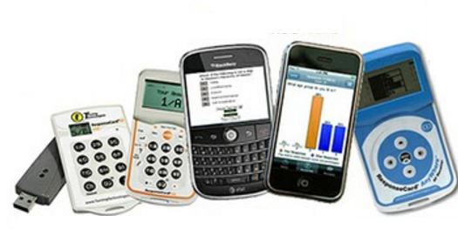
Nekaj o razrednih odzivnikih
Smart Response
Classroom Performance Systems (Clickers) in the Classroom

Slide 5
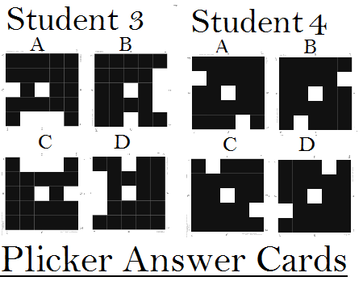
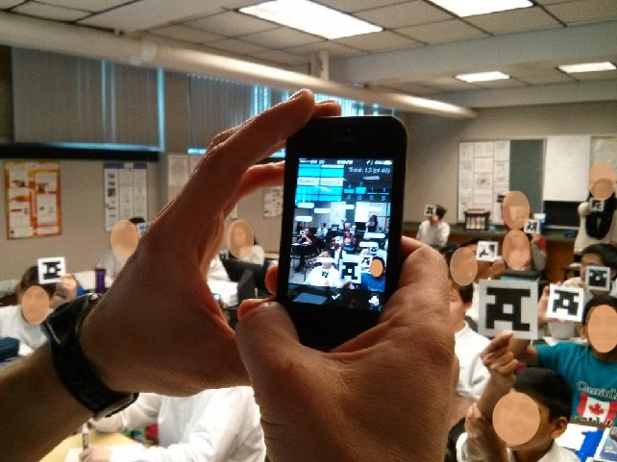
Plickers
Učitelj ima pametni telefon ali tabloco
Učenci odgovarjajo s Plicker karticami

Slide 6
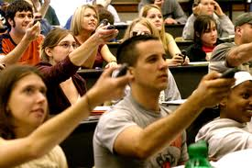
Kritika odzivnikom (glasovalnim sistemom)
Načrtovanje
Obseg vprašanj je omejen
Učenci ne morejo postavljati vprašanj
Niso integrirani z drugimi strategijami učenja
Uporaba
Učenci imajo vtis, da služijo le evidenci prisotnosti.

Slide 7
Spremembe v razredu
Študenti prinašajo svoje mobilne naprave v razred
Študentje več sprašujejo
Alternativa odzivnikom

Slide 8
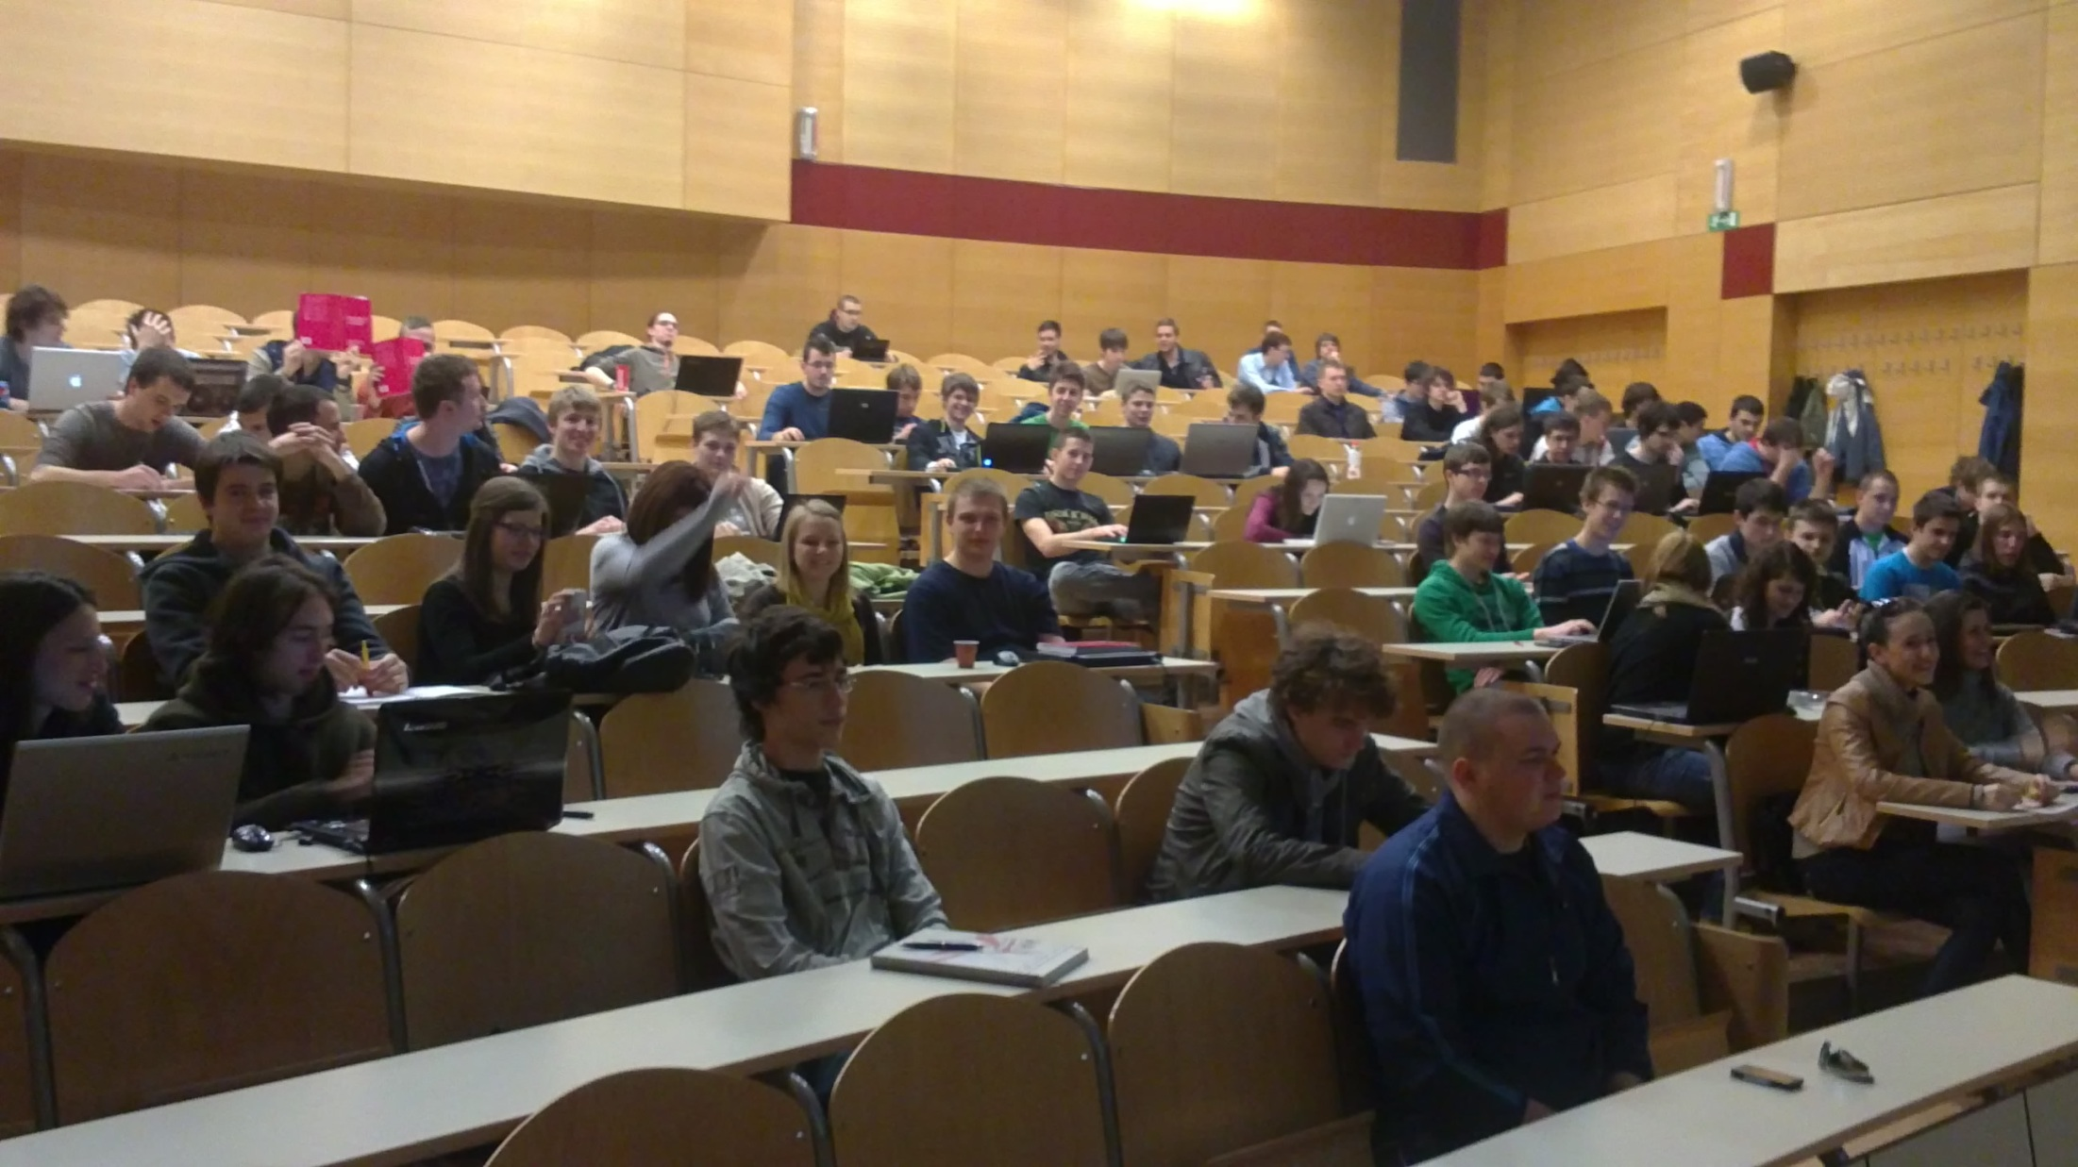
Odzivnik v predavalnici

Slide 9
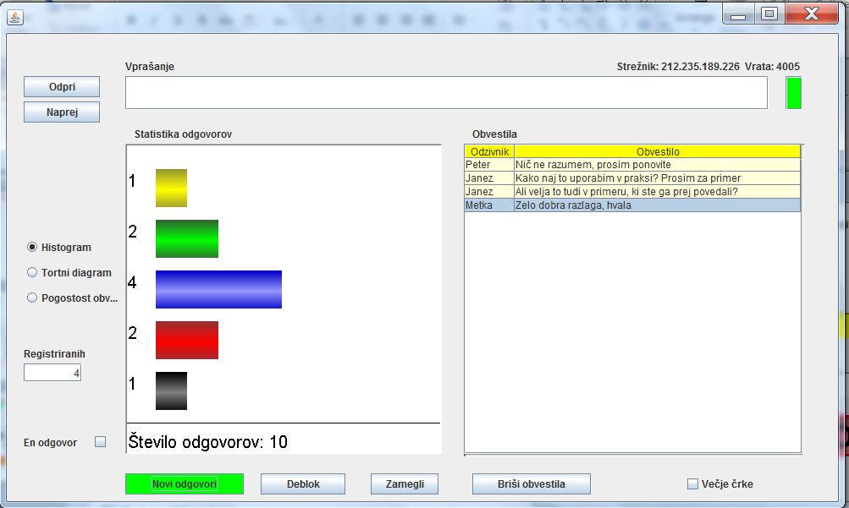
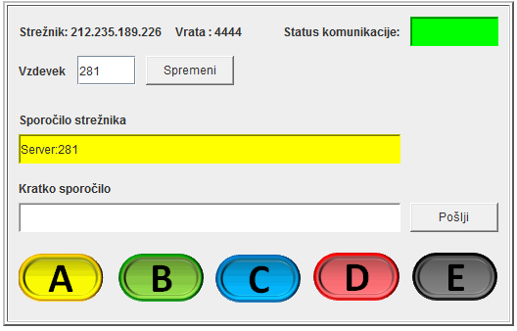
Spletni odzivniki
Preko brezplačnega brezžičnega dostopa do Interneta

Slide 10
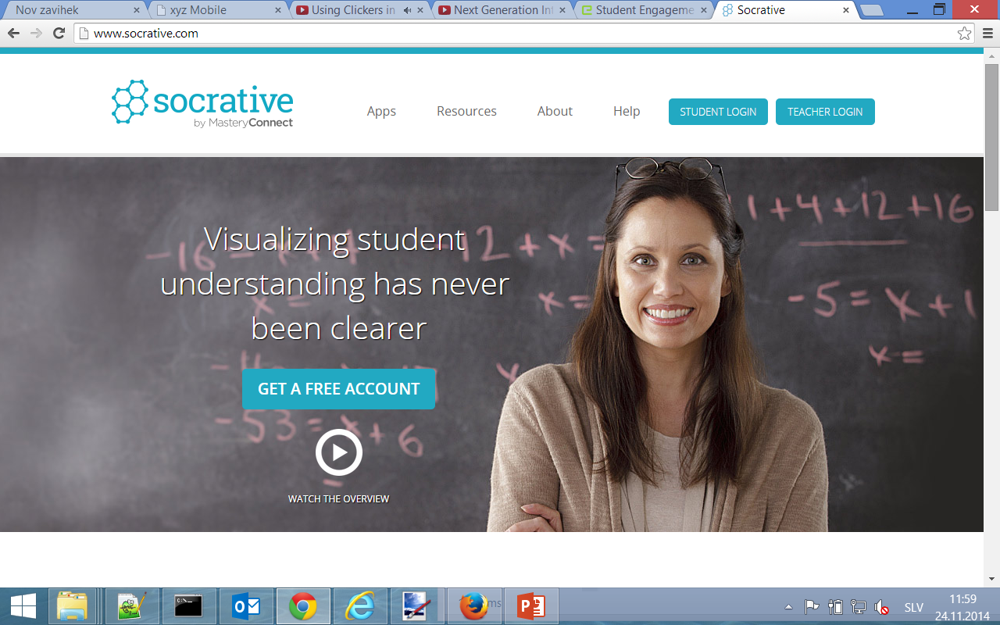
Socrative

Slide 11
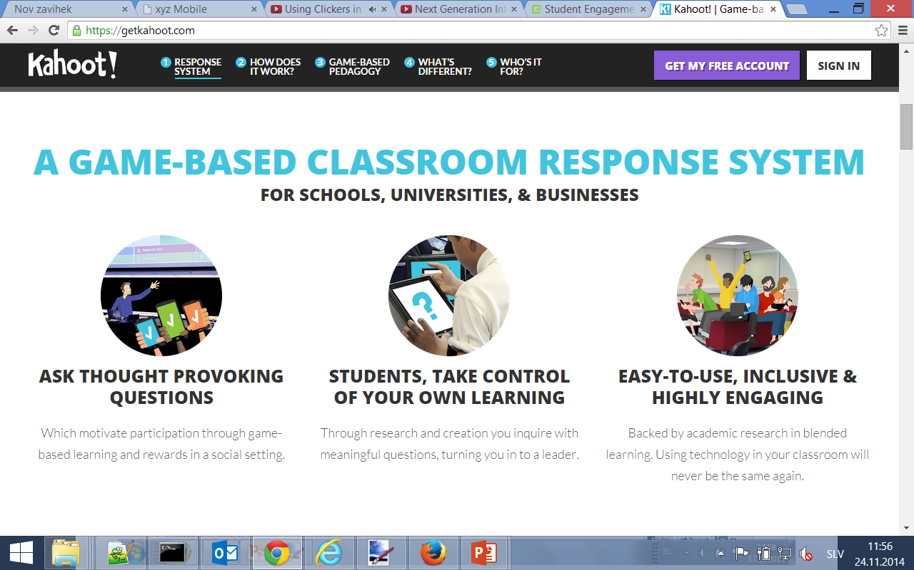
Kahoot

Slide 12
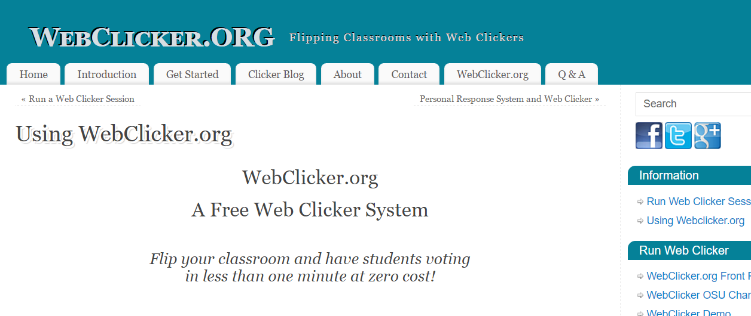
WebClicker.org

Slide 13
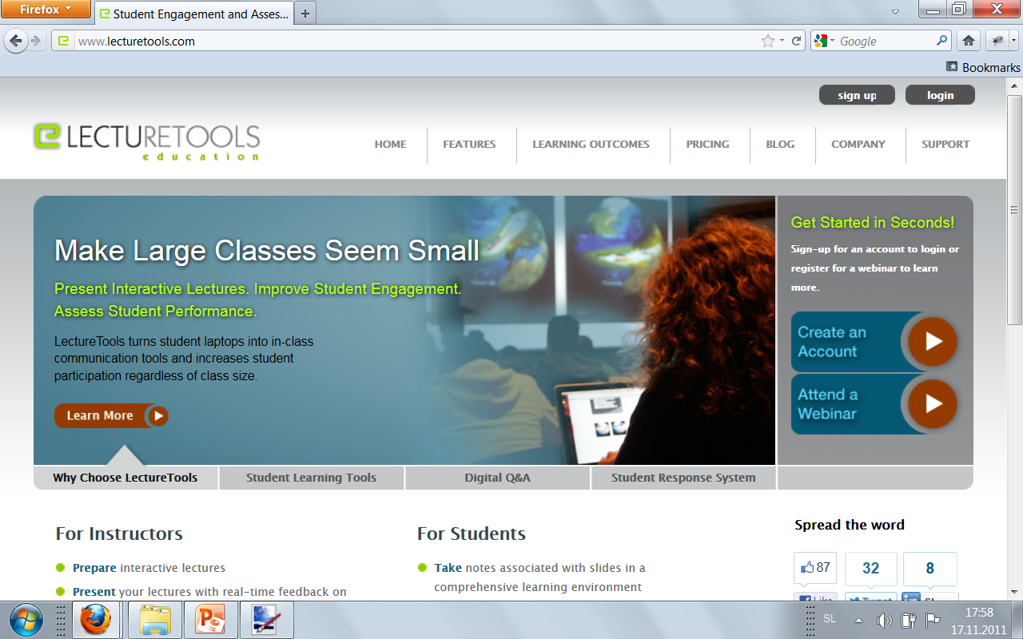
LectureTools
Spletna alternativa razrednim odzivnikom (clickers, responders)

Slide 14
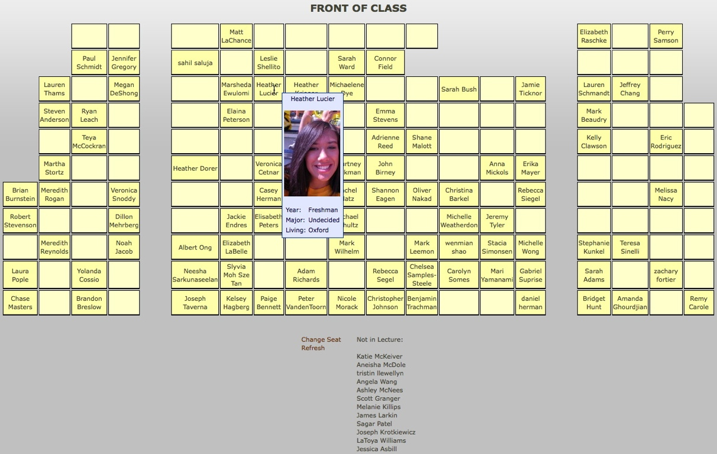
Pogled študenta: Socialno mreženje

Slide 15
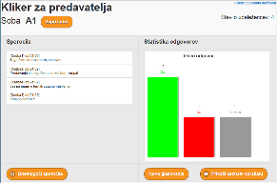
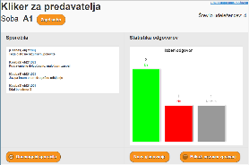
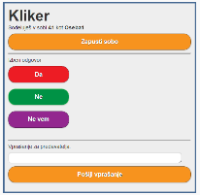
Kliker strežnik, sobe, udeleženci
KlikerServer.jar
Room1
Room2
Room n
Room1
Room n
Room2

Slide 16
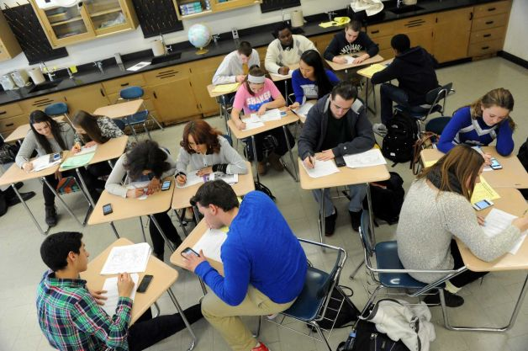
Skrb šole:
Do kakšne stopnje uvajanje mobilnih naprav v razred uvaja odvračanje oziroma raztresenost?
Do kakšne stopnje uvajanje mobilnih naprav v razred spreminja pozornost?
Do kakšne stopnje uvajanje mobilnih naprav v razredu spreminja vključevanje?
Do kakšne stopnje uvedba mobilnih naprav v razred spreminja učenje ?

Slide 17
Kaj se je spremenilo ob uporabi notesnikov v razredu?

Slide 18
Povzetek
Notesniki v razredu odvračajo pozornost:
Ne glede na to, pa imajo tudi prednosti
Študentje imajo občutek, da so bolj angažirani.
Študentje imajo občutek, da so bolj pozorni.
Študentje imajo občutek, da notesniki pozitivno vplivajo na njihovo učenje.

Slide 19
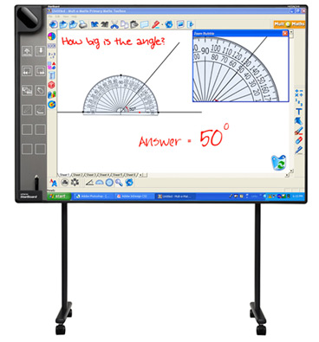
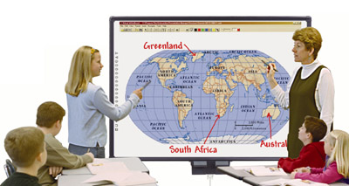
Interaktivne table
Smart IWB Video 1
Promethean IWB Video 2
WEB

Slide 20
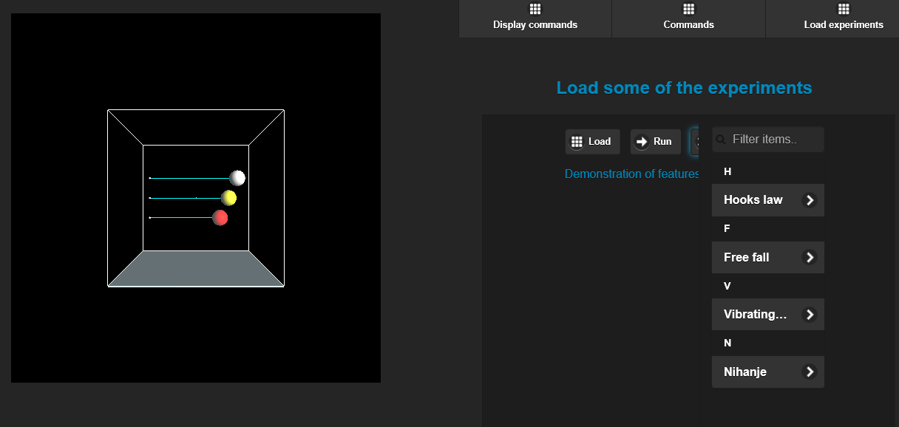
Interaktivni eksperimenti?
http://colos.fri.uni-lj.si/colos/xyzServer/si/xyzMobile.html
http://colos.fri.uni-lj.si/colos/xyzServer/si/remote.html

Slide 21
Viharjenje idej: primer scenarija
Definiramo problem in začnemo
Korak 1: Individualno viharjenje možganov
Vsak posameznik porabi 3 tihe minute za zapis idej. Vsako idejo zapiše ločeno.
Korak 2: Deljenje idej
Udeleženci posredujejo svoje ideje v skupni prostor
Korak 3: Druženje po skupinah
Edeleženci združijo ideje po podobnosti ali konceptih. Vsako skupino poimenujemo z eno besedo ali kratko frazo
Korak 4: Glasovanje
Udeleženci glasujejo , kateri koncept je najbolj primeren. Vsakemu konceptu da točke. Zmaga koncept z največ točkami

Slide 22
Kriteriji za izbiro orodja
1.Lahka uporaba in vzpostavitev
We're after something a team can use regularly. Something developers can use in retrospectives, executives can use to plan, some can use to explore requirements with prospects. This means it has to be super easy to set up a new session.
Also, anything you ask a team to try in front of each other needs to be easy to figure out. If it's confusing, people will get frustrated and embarrassed, and that's no good for your meeting.
2. Lahko povabilo udeležencev
we're assuming you'll also be running online meeting software at the same time. There needed to be a way to put a simple link in the meeting that everyone could just click to access the brainstorming tool, or some other really easy way to get everyone connected on-the-fly.
3. Angažiranost in vzpodbujanje
Techniques like the KJ-Method naturally engage everyone in the meeting. When you're together, it's very obvious if someone isn't enjoying the process or simply isn't participating. We wanted to find something that encouraged this kind of energy and transparency in an online setting.

Slide 23
Kriteriji za izbiro orodja
4. Načini izvoza rezultatov, ne „copy and paste“!
When you use real sticky notes, someone has to type up the big ideas afterwards. We want to put the ideas from our brainstorm to use!
Since you type your ideas into these tools in the first place, it seemed like it should be a no-brainer to get them out again. Shockingly, not so.
5. Skladnost s potrebami delovnega srečanja
Most effective working sessions involve 3 to 10 people meeting for less than 2 hours. We wanted to find something that worked well at this scale. Some of the products we found were clearly intended for individual use, and others optimize for big conference events with hundreds or even thousands of participants
6. Vključujoč design in dostopnost
When you brainstorm, you want to get everyone's ideas in the conversation. work for people with disabilities who may use assistive technologies, and for those joining on phones or other devices.

Slide 24
Uporaba sodelavnih urejevalnikov dokumentov za viharjenje
Google Docs
Microsoft Word Live
Etherpad
Quip
Mural

Slide 25
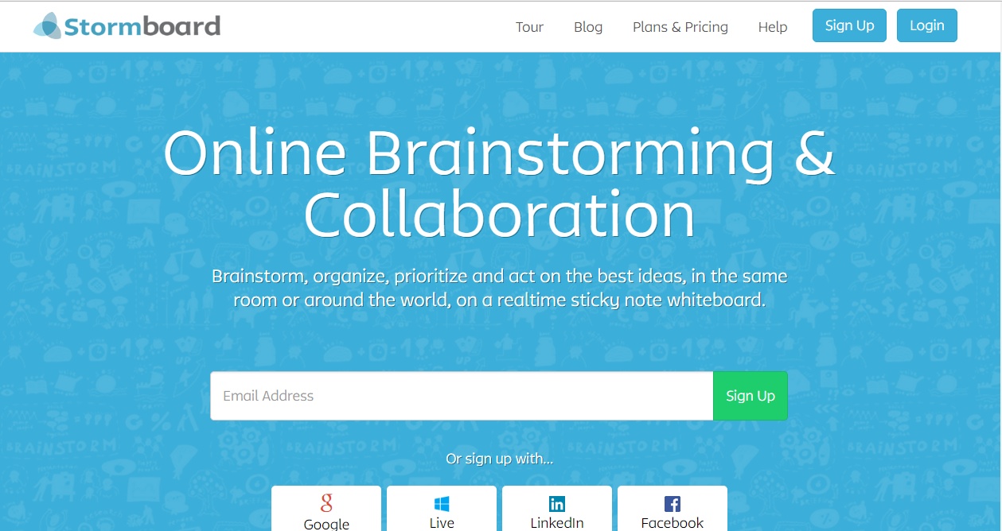
Spletno viharjenje: StormBoard

Slide 26
Prosto dostopna orodja za viharjenje

Slide 27
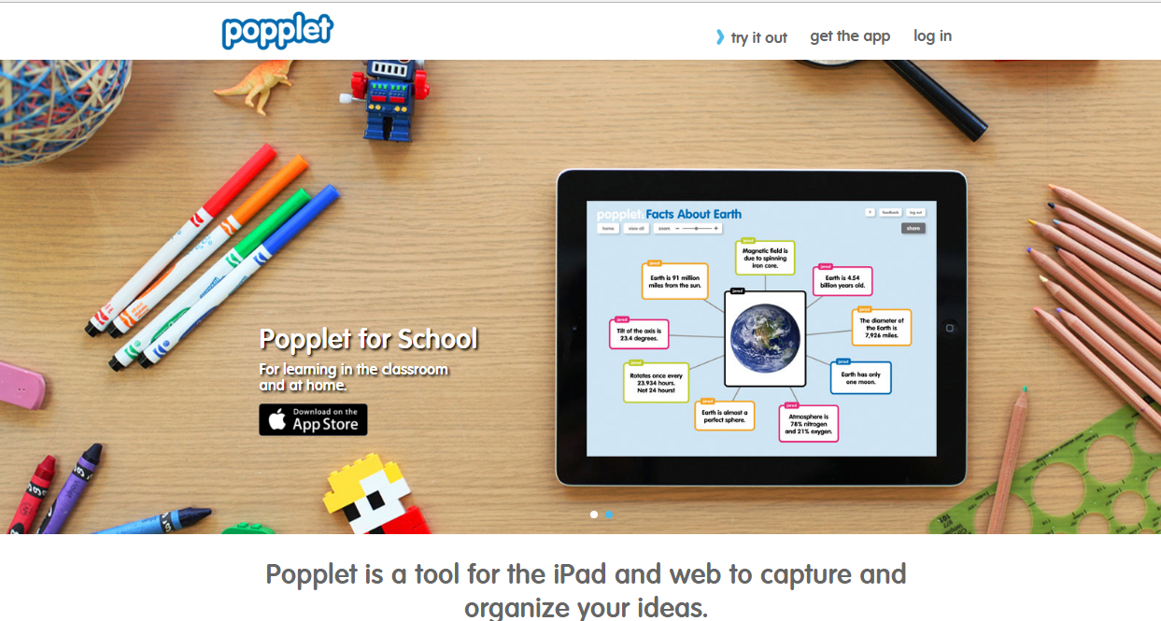
Popplets
YOUTUBE

Slide 28
Elektronsko preverjanje znanja

Slide 29
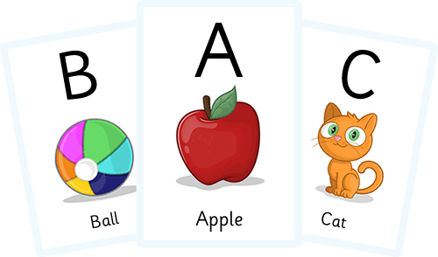
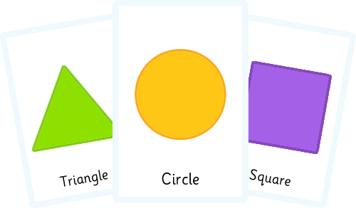
Učne kartice (Flashcards)
Avtorska orodja
Spletne učne kartice o računalništvu

Slide 30
Pomen elektronskega ocenjevanja
WEB

Slide 31
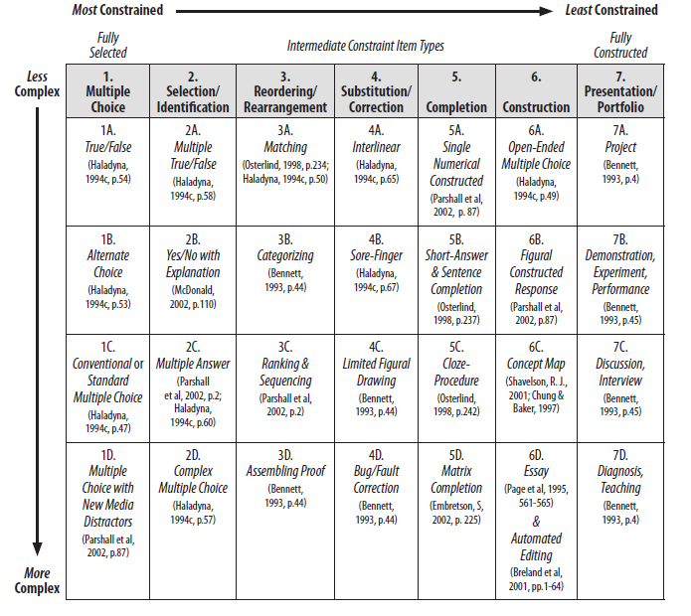
Klasifikacija načinov elektronskega ocenjevanja

Slide 32
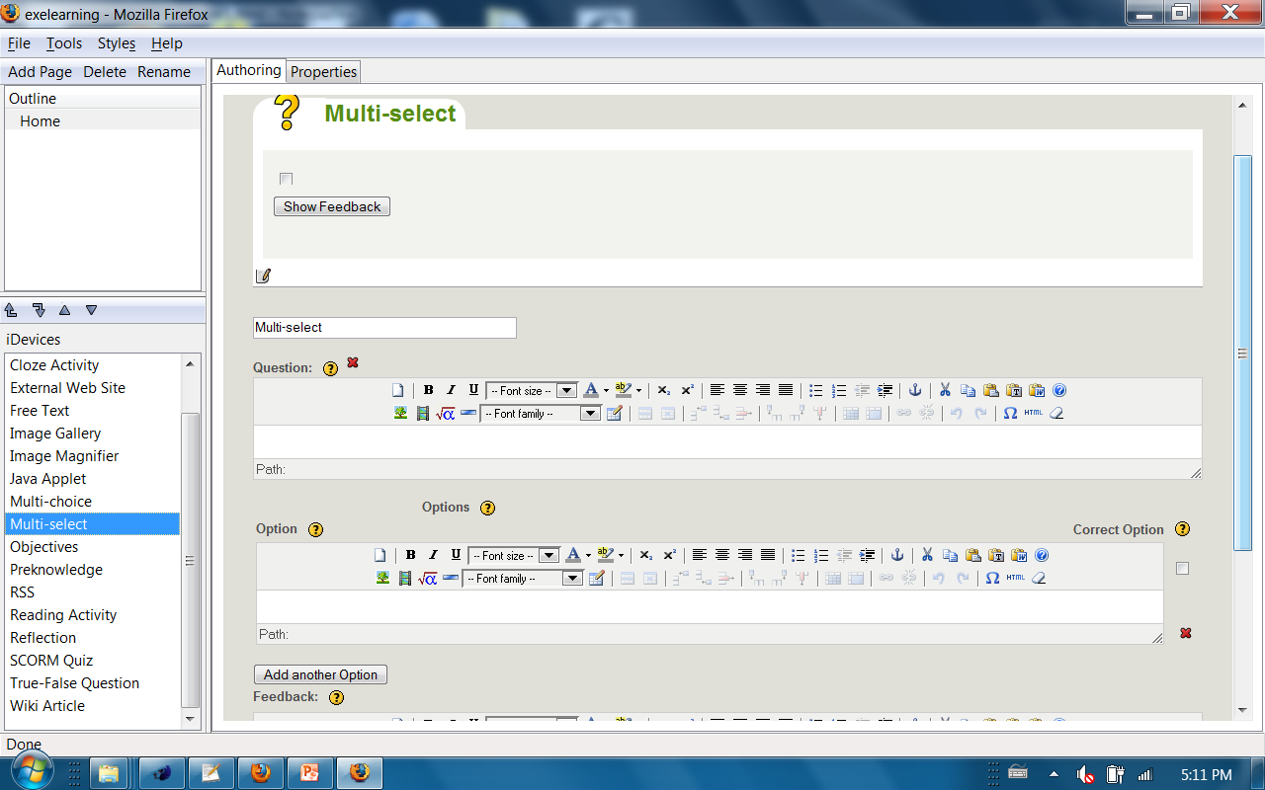
eXe Learning?
DEMO

Slide 33
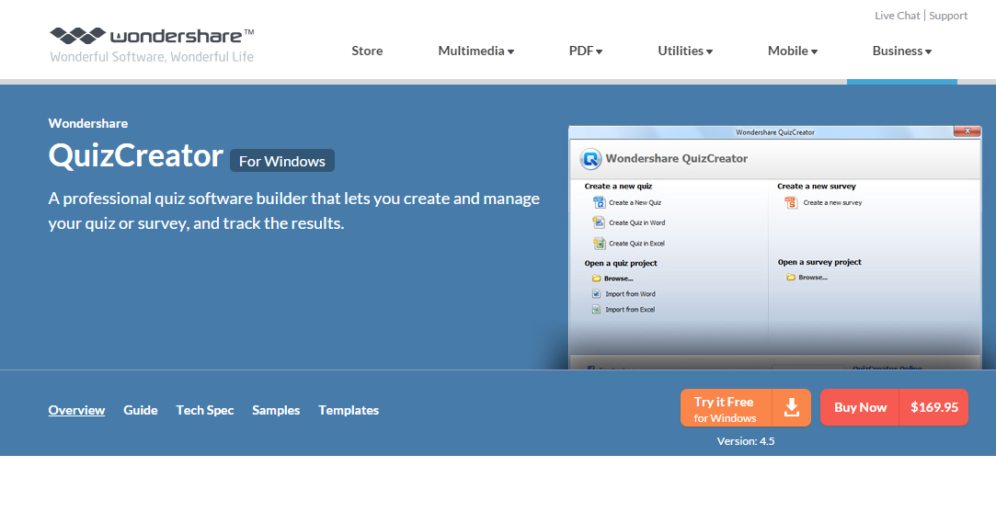
Wondershare QuizCreator
WEB
DEMO1

Slide 34
Hot Potatoes
Movie

Slide 35
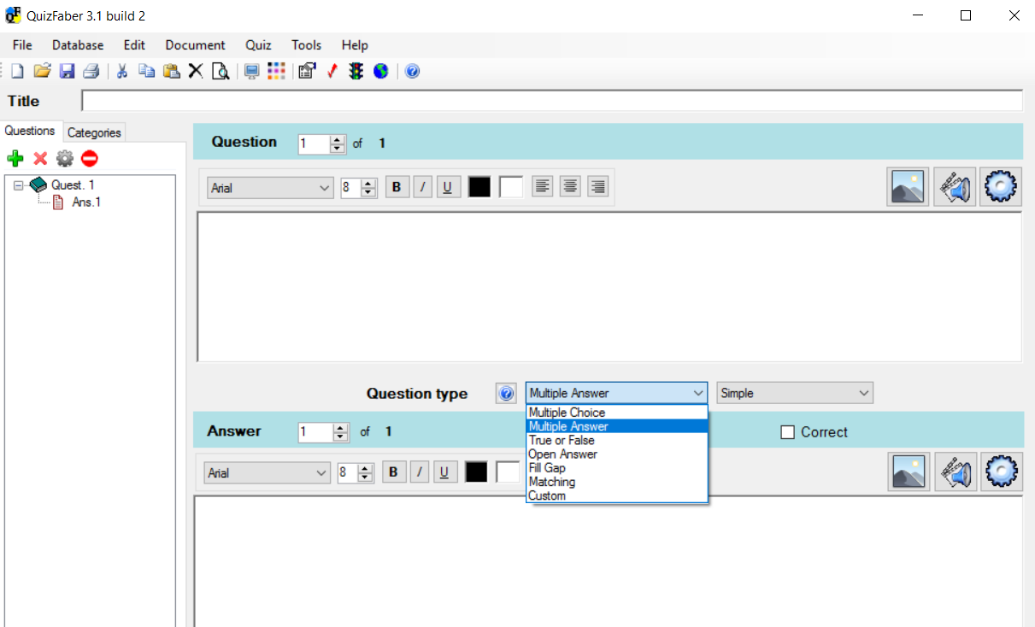
QuizFaber
DEMO

Slide 36
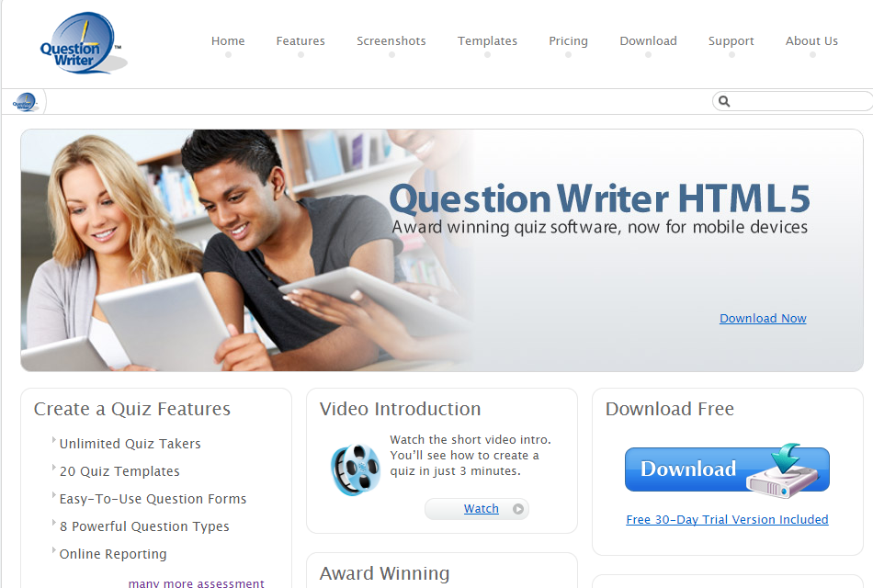
Question Writer

Slide 37
IMS QTI

Slide 38
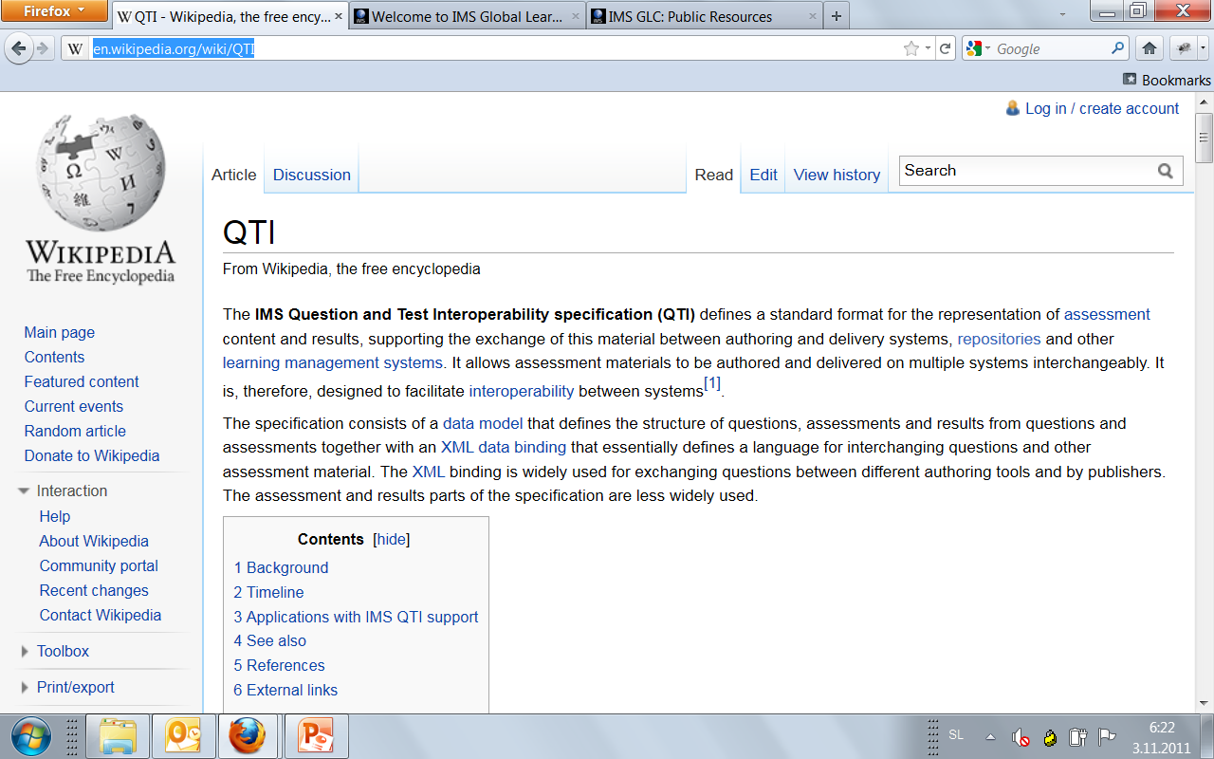
WIKI: QTI

Slide 39
QTIWorks

Slide 40
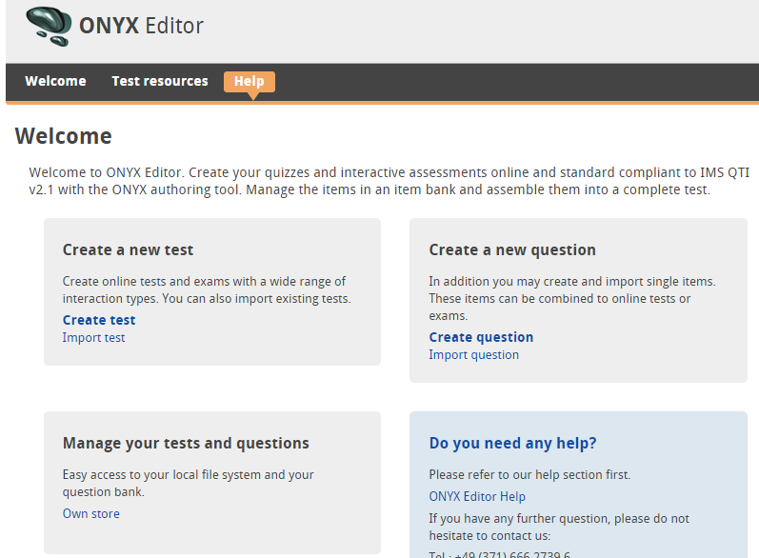
QTI urejevalnik (ONYX Editor)

Slide 41
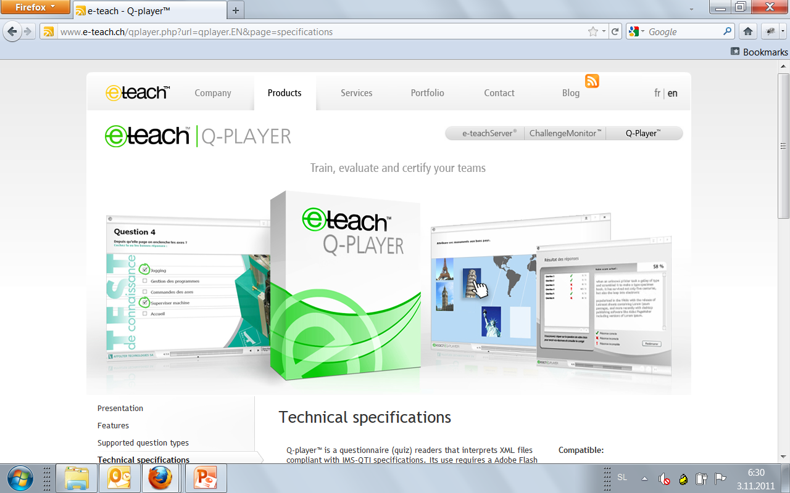
QPlayer

Slide 42
XQuestion

Slide 43
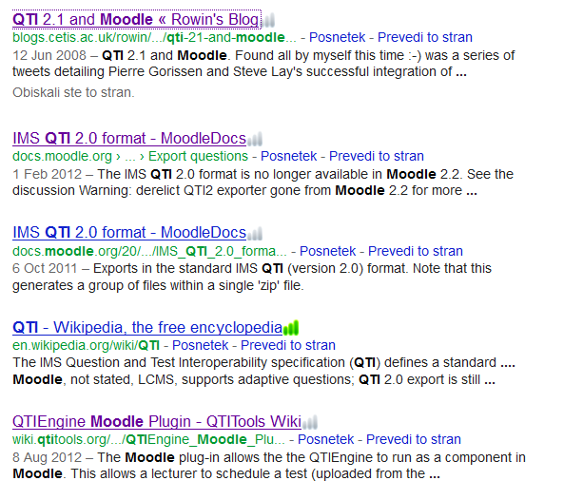
QTI in Moodle?

Slide 44
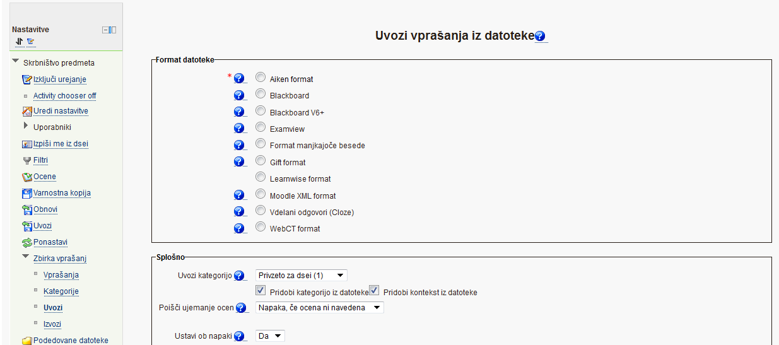
Uvoz kviza v Moodle
ExamView: več, demo

Slide 45
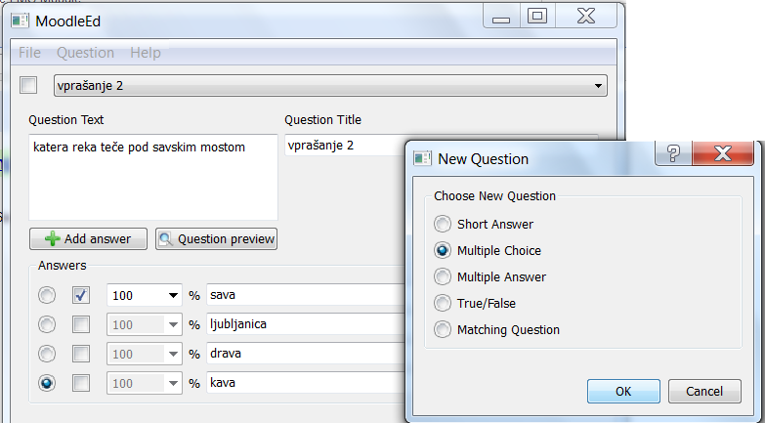
GIFT format
WEB
DEMO

Slide 46
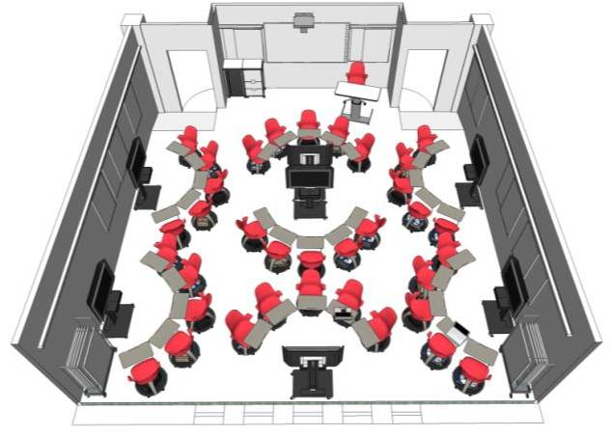
Interaktivno in sodelavno učenje programiranja
Interaktivno poučevanje Pythona
Motivirano učenje Pythona
Morda še kaj

Slide 47
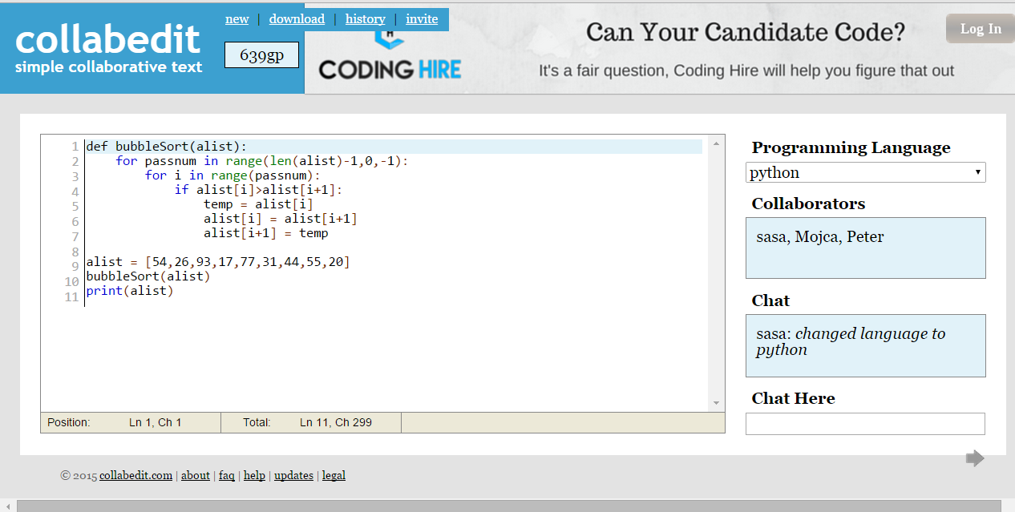
collabedit

Slide 48
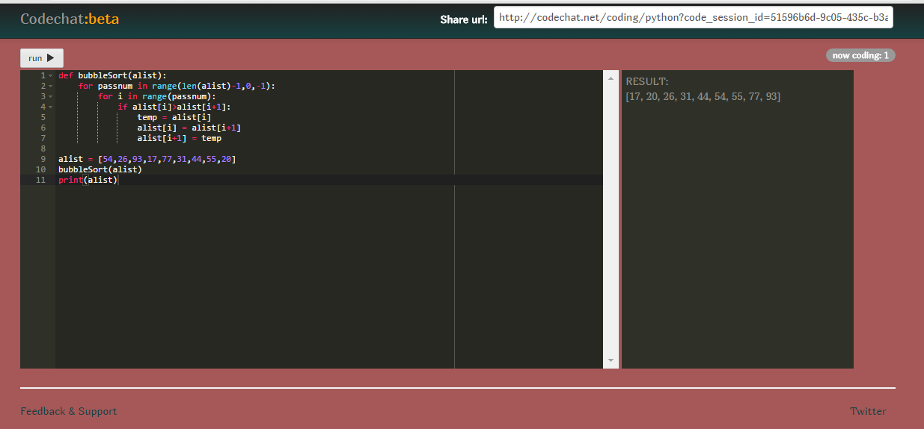
CodeChat

Slide 49
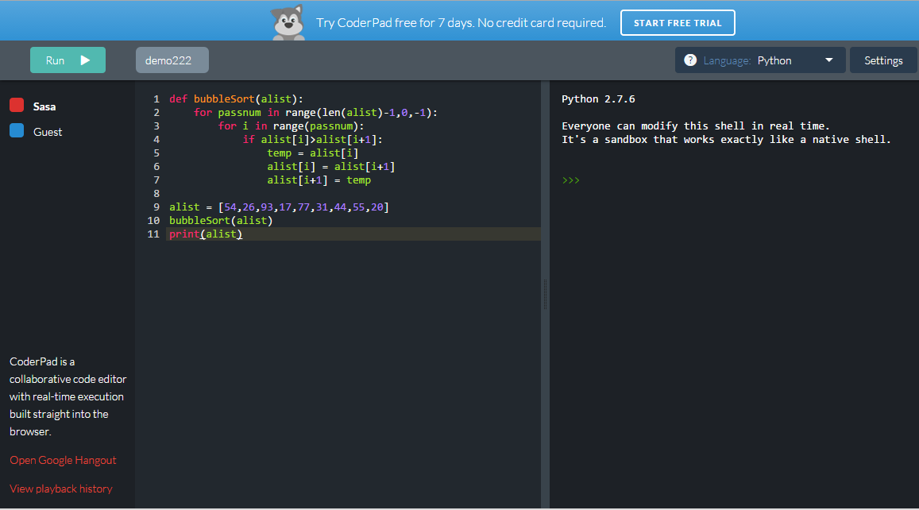
coderpad

Slide 50
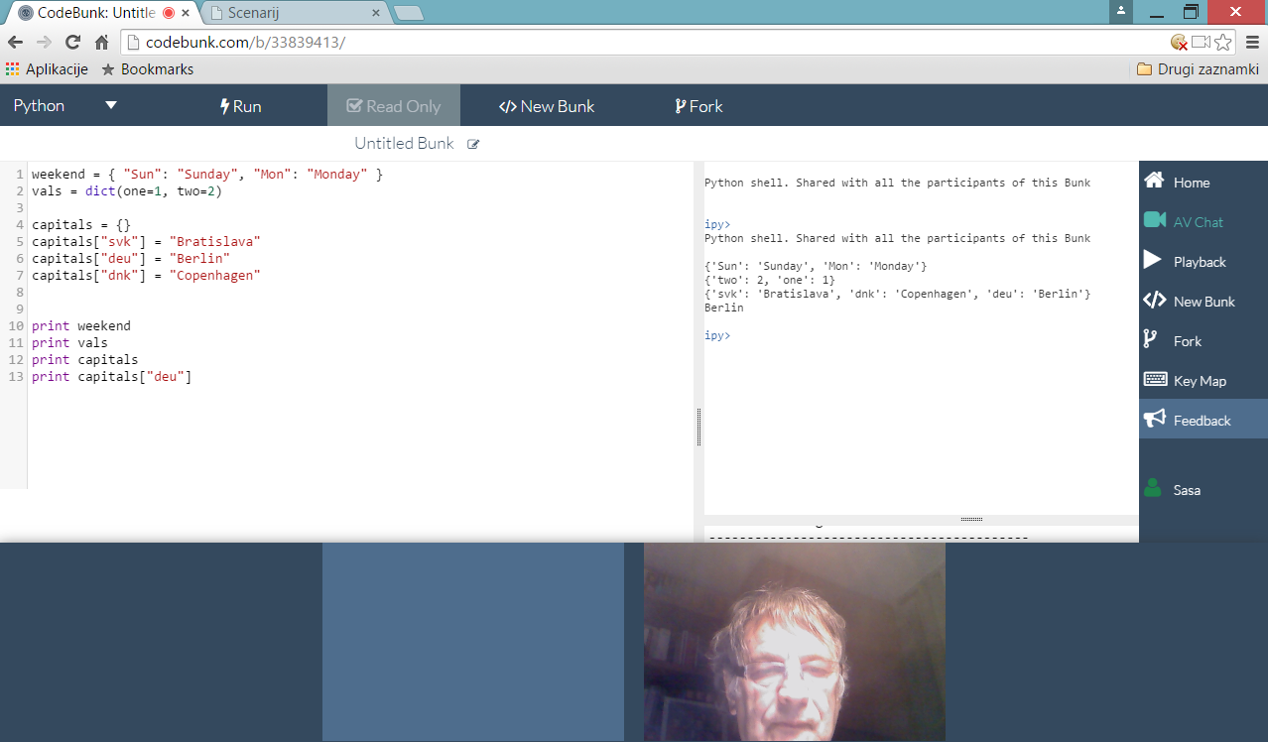
CodeBunk

Slide 51
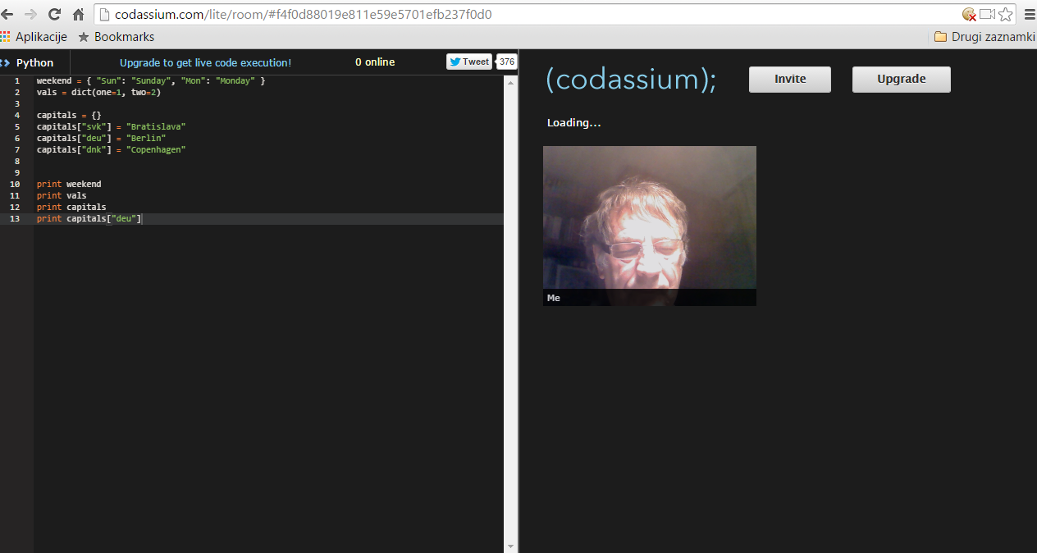
Codassium

Slide 52
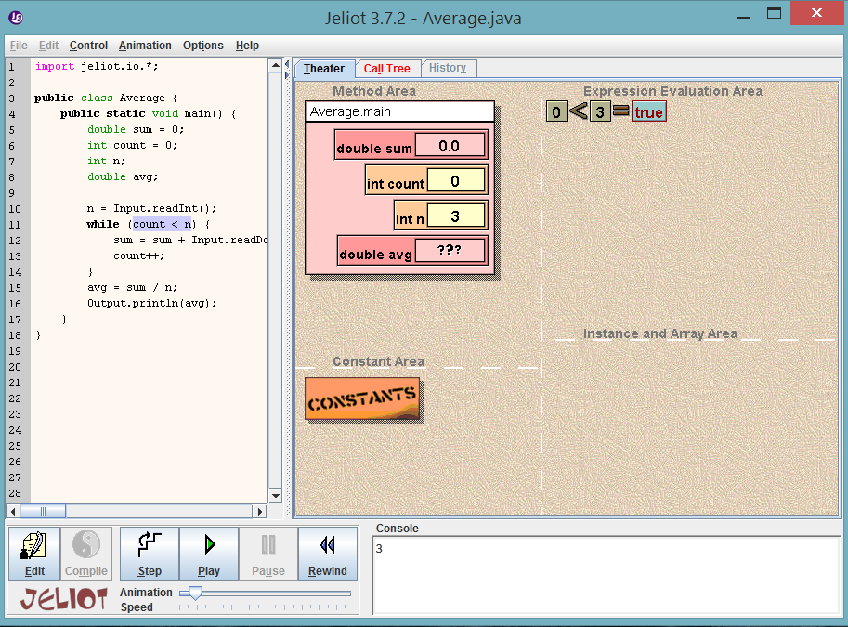
Jeliot
DEMO

Slide 53
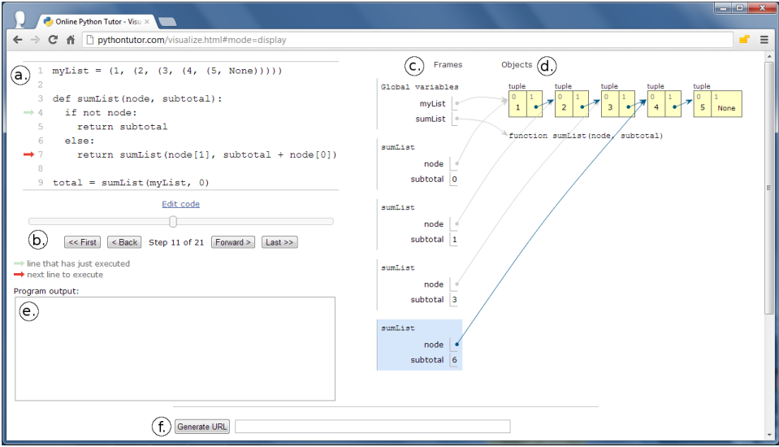
Pythontutor

Slide 54
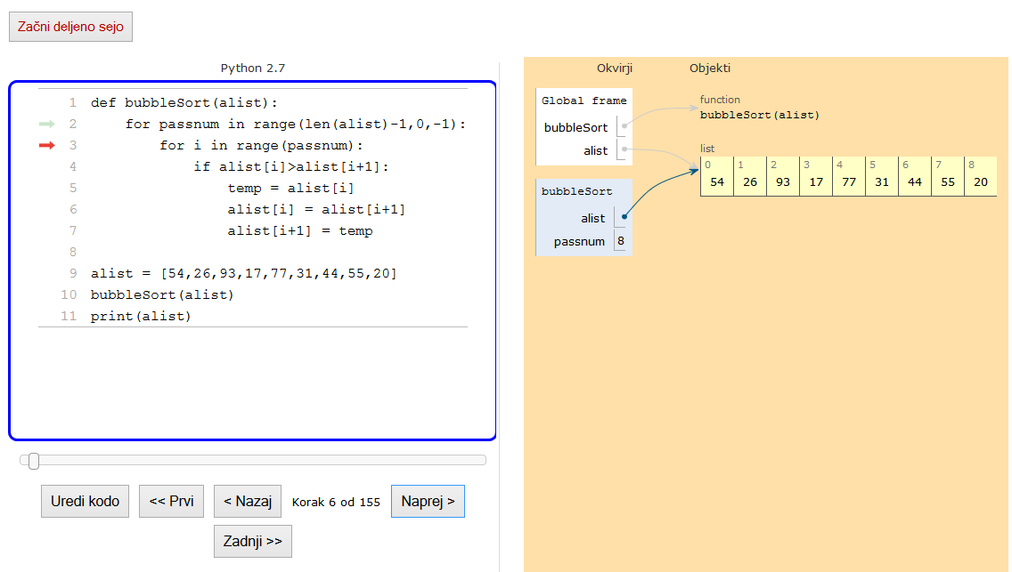
OPT (predelava Online PythonTutor)
Poženemo strežni program
Poženemo spletno stran

Slide 55
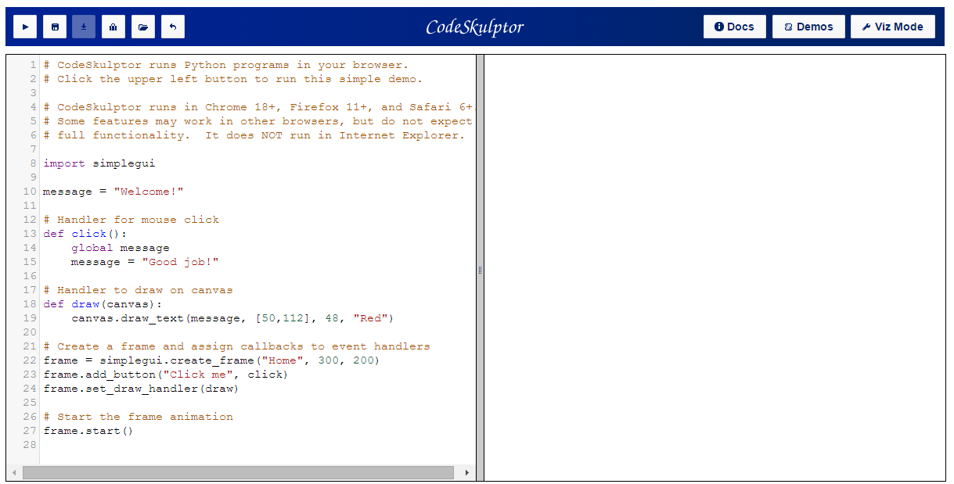
CodeSkulptor

Slide 56
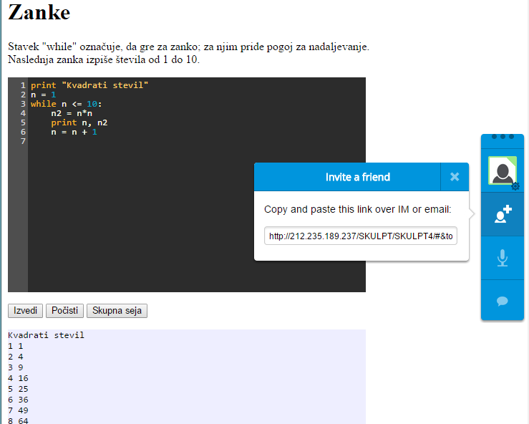
Napravimo si sami sodelavno spletno aplikacijo
Skulpt1
Skulpt2
Skulpt3
skulpt4

Slide 57
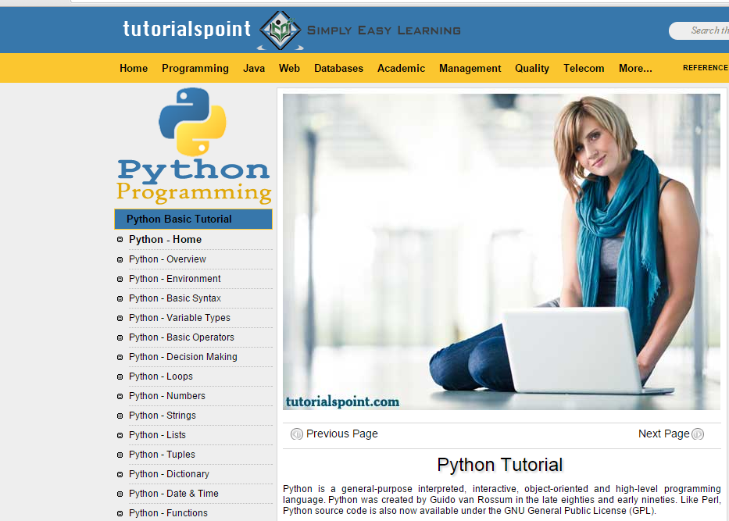
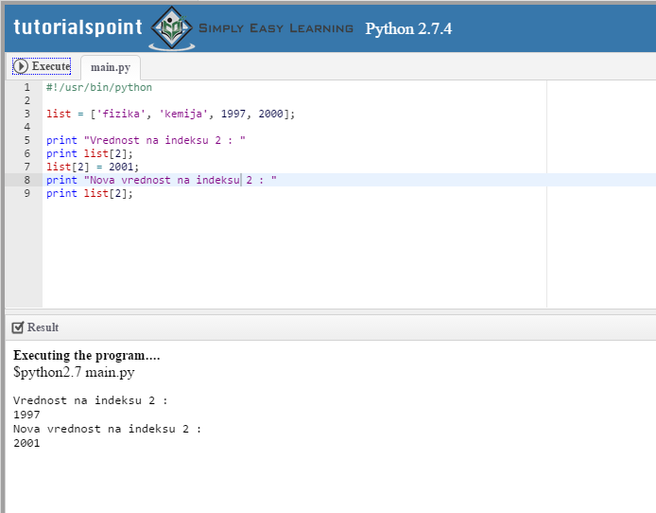
Tutorialspoint: Python
WEB

Slide 58
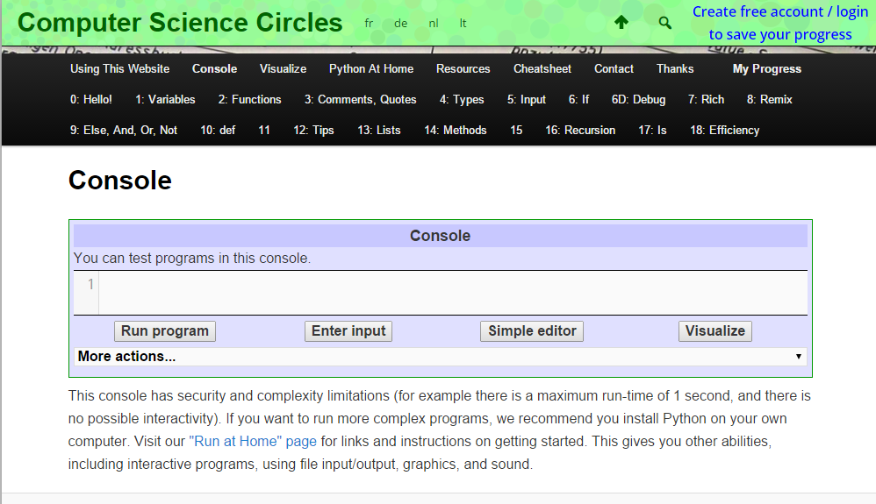
Še en interaktivni učbenik za Python
WEB

Slide 59
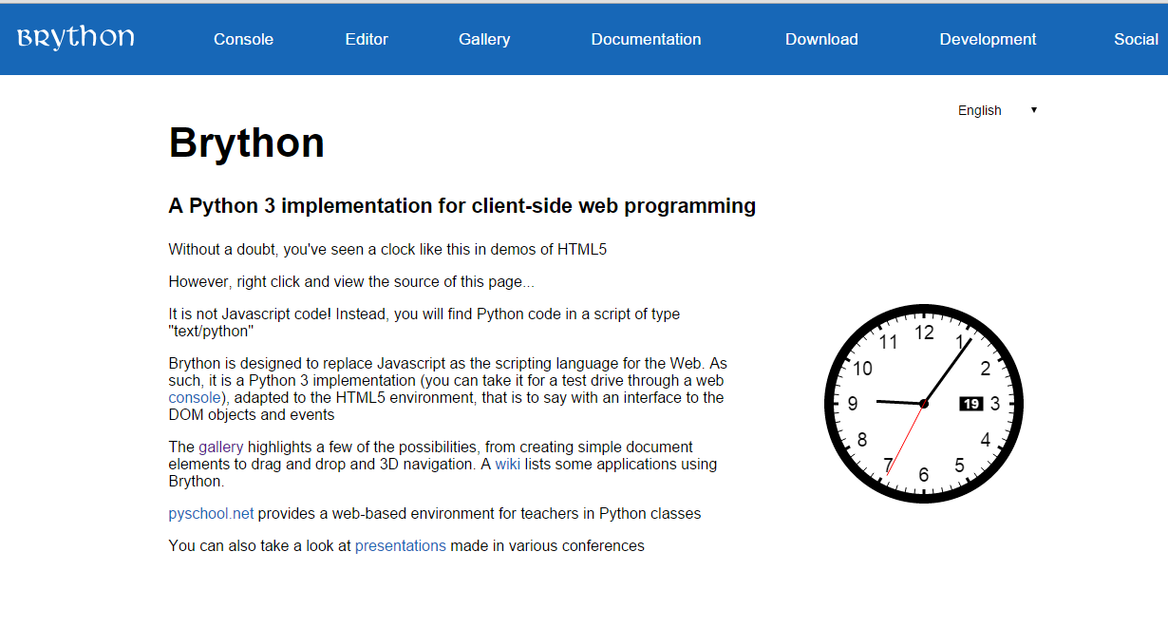
Brython

Slide 60
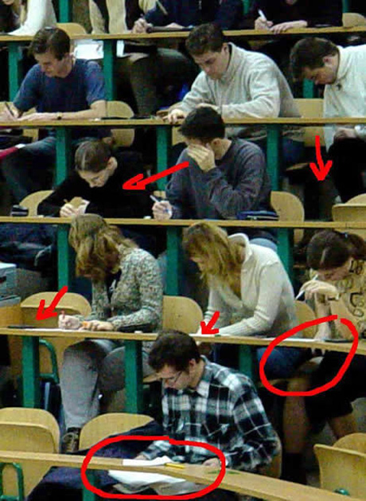
Pa še kaj o goljufanju ☺

Slide 61
Nekaj načinov goljufanja
Najem drugega, da napiše tvojo nalogo
Iskanje odgovorov med samim izpitom
Nakup rešitev preko interneta ali od drugih študentov
Delitev izpitnih vprašanj in odgovorov
„Komunikacijski kanal“ za delitev testov
Sabotaža tehnologije

Slide 62
Kako preprečiti goljufanje pri spletnih izpitih
The most common way for students to cheat is by looking up the answer in a textbook.
The single most effective strategy for eliminating it is to assign time-limits on tests. A timed evaluation requires students to answer the questions in a certain amount of time. If the time-period is aggressive enough, students won’t have time to look up all the answers.
On average, you should allow 30 seconds per multiple-choice question and 15 seconds per true or false question.
Essay-type questions should be timed based on the complexity of the topic and the expected length of the answer.

Slide 63
Goljufanje z učbeniki
Asking students to apply their knowledge to a unique situation not covered in their textbook is also effective.
Application questions can’t be looked up. Students truly have to understand the material in order to properly answer the question.
While they may take the time to read the textbook, they will still need to truly understand what they’ve read in order to successfully answer the question.

Slide 64
Goljufanje s sošolci
If students know each other, they may get together (offline or online) and try to take the test together.
To eliminate this problem, randomize both the questions and answers on your quiz. Additionally, only select a subset of questions from a larger bank. Presenting different screens to the students makes it very difficult for them to cheat. This strategy coupled with a timed quiz makes it virtually impossible.

Slide 65
Tiskanje vprašanj in odgovorov
Assume that students will print the questions. If you also provide the answer to these questions (after the test is submitted of course!), also assume students will print the results.
Randomize the order of your questions and answers and only present a subset of questions. If you're serious about preventing cheating, I recommend having 10 times as many questions in your bank as you will display on your test. If students can only print 10% of the questions at any time, they will need at least 10-20 different copies in order to put together a useful printout.
Additionally, configure the system so that each student can only take the test once. Assuming that (a) not everyone in the class is a cheater and (b) not all students know each other (which is typically true of online classes), it will be practically impossible for a few individuals to print all of the questions and answers.

Slide 66
Izpit dela nekdo drug namesto nas
Students will sometimes pay classmates to take online evaluations for them. To eliminate current classmates from taking each other's test, only make them available for a short time. For example, you could require everyone take a 30-minute test within a 1-hour window. Since a 30-minute test usually takes 40 minutes to complete (by the time you log in, read the instructions, etc.), a single classmate will not have time to take 2 tests within the window.
To prevent former students from taking an exam, use once again the randomized question/answer strategy. If the former classmate hasn't taken the test in a few months and the questions/answers are different then those he/she last took, chances are this cheating strategy will not be successful.
To take it one step further (assuming all students live in a close geographic area), have the test in a computer lab and warn the students that the exam might be proctored, which means students need to show ID. Proctoring the exams even occasionally will discourage students from having someone else take the exam in their place.

Slide 67
Goljufanje v virtualnem razredu
A traditional classroom allows the supervisor to visually monitor students during exams. While this is not possible in a virtual environment, placing time restrictions for the completion of an online exam can take care of the cheating woes in a virtual set up.
The exam automatically gets submitted to the instructor, once the time is up. This can restrict, if not completely eliminate online cheating, particularly in a multiple choice quiz type pattern of exam. Like, students will have no time on hand to look up for answers if an exam comprises of answering 20 multiple choice questions in 18 minutes.

Slide 68
Nitkan pogovor in goljufanje
Tools like threaded discussions allow the instructor to gauge the level of understanding among students. Communication, discussion and debate on a topic can be carried out in a threaded discussion.

Slide 69
Nitkan pogovor in goljufanje
Being synchronous, they provide no time for the students to cheat, since the responses too are expected in real time.
The writing style of the student as well as the flow of the text gives away the fact whether plagiarism or cheating is at work.
Group chat will allow discussions and interaction between students and the instructor, where they can assess the students casually.
Also the time commitment required for synchronous communication is a deterrent for cheating.

Slide 70
Plagiarizem v virtualnem razredu
The easy availability and abundance of online term papers has made it easier for students to plagiarize content. With a simple click of the mouse, they can now copy and paste text in their online papers. Copying from websites is another common method of plagiarizing content. But, while this is largely prevalent among the student community, detection of t is also becoming easier by the day. Unlike in a traditional classroom, the electronically submitted papers can be run through the plagiarism detection softwares or websites.

Slide 71
Respondus
DEMO

Slide 72
VIRTUAL INVIGILATOR
it does not attempt to create a perfectly secured testing environment on an unsecured piece of hardware nor does it attempt to directly monitor the actual human that is completing the exam using technology. The students are allowed to use their local computers in any way they see fit and the monitoring of human actions is left up to other humans who can still notice suspicious behavior better than any proven and commercially
available computer system. The Virtual Invigilator is instead acting to detect cheating by watch the network communications of a student.

Slide 73
LanSchool is clean, simple and easy-to-use. Teachers love it.
It is reliable and uses significantly less network bandwidth than other solutions.
It is complete, no add-ons are required to block the Internet, Applications, Printing and USB drives.
It keeps working even when students try to disrupt it.
It costs less and is better supported than any other solution on the market.
It supports PCs, Macs, Linux and Thin Clients such as NComputing, Terminal Services and Citrix.

Slide 74
Google Docs in ankete

Slide 75
Google Docs: Forms

Slide 76
Priprava ankete
Izberemo novo formo in jo poimenujemo.
Prvi dve vprašanji sta lahko tekstovni: ime in priimek..
Dodajamo vprašanja.
Za vsakega napišemo besedilo in izberemo enega od možnih tipov
Text and paragraph text.
Multiple choice (tudi kot true / false).
Scale (1 to 10)
Check boxes (Izberemo vse, ki so pravilni).
Za vsako vprašanje lahko določimo, ali je odgovor zahtevan ali ne.
Notes:
Show different invitation options
Demonstrate different email accounts
While there is a limit to simultaneous editing, people can still view the document.

Slide 78
Obravnava odgovorov
Odgovore lahko vidimo …
Kot preglednico posameznih odgovorov (uporabno pri ocenjevanju).
Kot statistični povzetek.
Notes:
Show different invitation options
Demonstrate different email accounts
While there is a limit to simultaneous editing, people can still view the document.

Slide 79
Form Tools

Slide 80
SurveyMonkey

